Slide 1
Quantitative Finance (in Python)

Slide 2
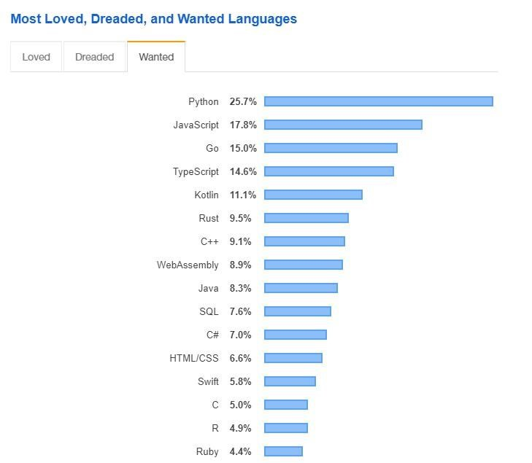
Python Programming Language
Python is the #1 programming language mainly because of scientific computing and machine learning
there are a huge number of libraries you can rely on – SciPy, SkLearn or Keras
data science and artificial intelligence related applications rely extremely heavily on Python
most of the scientific community use Python – physics simulations, complex networks etc.

Slide 3
Python Programming Language
Python is an interpreted programming language
it means that the code is interpreted and processed at run-time so there is no need for compiling the program
it is and object oriented programming language – it may encapsulate code within give classes and objects
easy to use with all the major databases

Slide 4
Why to Use Python?
Python is very easy to learn compared to other
Programming languages such as C or C++

Slide 5
Why to Use Python?
Python is very easy to learn compared to other
Programming languages such as C or C++
several available libraries in machine learning, statistics and numerical methods that significantly reduces time to implementation
(NumPy, SciPy, Pandas + plugins)

Slide 6
Why to Use Python?
Python is very easy to learn compared to other
Programming languages such as C or C++
several available libraries in machine learning, statistics and numerical methods that significantly reduces time to implementation
(NumPy, SciPy, Pandas + plugins)
quite fast (not as fast as C or C++) Python provides scientific computing components that are heavily optimized via vectorization

Slide 7
Financial Models (Quantitative Finance)

Slide 8
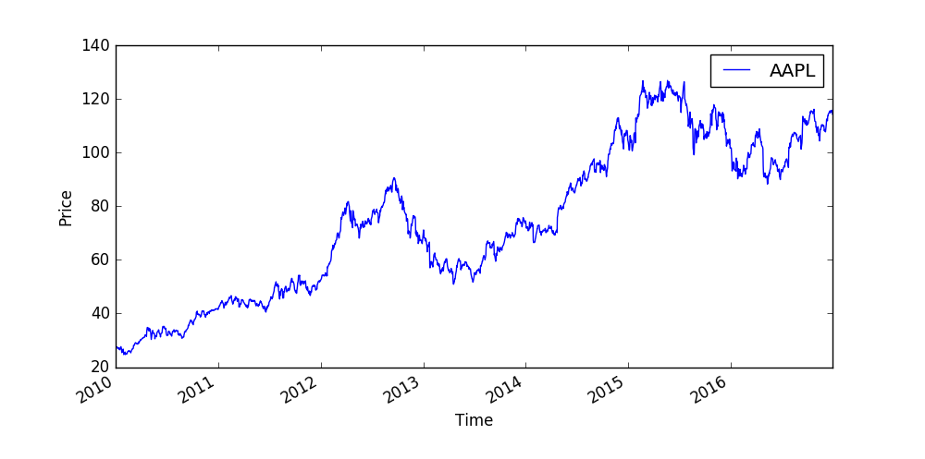
Financial Models

Slide 9
Financial Models
Most of the finance related models rely heavily on historical data which
means that we assume that the conditions are not going to change

Slide 10
Financial Models
Most of the finance related models rely heavily on historical data which
means that we assume that the conditions are not going to change
Modern Portfolio Theory (Markowitz-model)

Slide 11
Financial Models
Most of the finance related models rely heavily on historical data which
means that we assume that the conditions are not going to change
Modern Portfolio Theory (Markowitz-model)
Capital Asset Pricing Model (CAPM)

Slide 12
Financial Models
Most of the finance related models rely heavily on historical data which
means that we assume that the conditions are not going to change
these models are static in
the sense that we calculate the
parameters of the models based
on data in the past
NOT ALWAYS WORKING FINE !!!
for example the 2008 big financial
crisis and the loan crisis
Modern Portfolio Theory (Markowitz-model)
Capital Asset Pricing Model (CAPM)

Slide 13
Financial Models
Most of the finance related models rely heavily on historical data which
means that we assume that the conditions are not going to change
these models are static in
the sense that we calculate the
parameters of the models based
on data in the past
NOT ALWAYS WORKING FINE !!!
for example the 2008 big financial
crisis and the subprime mortgage crisis
Modern Portfolio Theory (Markowitz-model)
STATIC MODELS
Capital Asset Pricing Model (CAPM)

Slide 14

Financial Models
We should use dynamic models instead or take non-linear relationships
between the features (financial parameters) into account
DYNAMIC MODELS MAY BE BETTER !!!
→ so maybe we should define how the parameters evolve in the
course of time and use the models accordingly
$$\frac{∂f(t,x,y,z,…)}{∂t}$$
= 0

Slide 15
Stocks (Quantitative Finance)

Slide 16
Stocks
stocks are the ownership of a small piece of a company
this entitles the owner of the stock to a proportion of the corporation’s asset and profits equal to how much stock they own
shares are the units of stocks

Slide 17
Stocks
if you have a good idea then you can raise capital by selling
off future profits in the form of shares
the investor (or shareholder) gives you cash
in return he gets a contract stating how much
of the company he owns
THIS IS HOW SMALL COMPANIES BEGIN !!!

Slide 18
Stocks

Slide 19

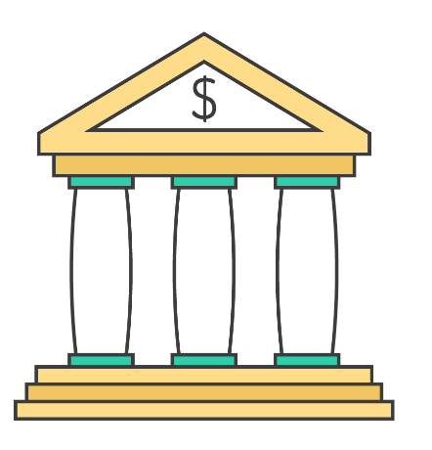




Stocks
the STOCK EXCHANGE has
the list of all the companies
that want to raise capital
(brings together buyers and sellers)
investors use BROKER FIRMS
that have the ability to
buy and sell shares
companies that want to
grow their businesses
and want to raise capital
there are the investors
who want to find the right
company to invest in

Slide 20
Stocks
the STOCK EXCHANGE has
the list of all the companies
that want to raise capital
(brings together buyers and sellers)
investors use BROKER FIRMS
that have the ability to
buy and sell shares
companies that want to
grow their businesses
and want to raise capital
there are the investors
who want to find the right
company to invest in

Slide 21
Stocks
the STOCK EXCHANGE has
the list of all the companies
that want to raise capital
(brings together buyers and sellers)
investors use BROKER FIRMS
that have the ability to
buy and sell shares
companies that want to
grow their businesses
and want to raise capital
there are the investors
who want to find the right
company to invest in

Slide 22
Stocks
the STOCK EXCHANGE has
the list of all the companies
that want to raise capital
(brings together buyers and sellers)
investors use BROKER FIRMS
that have the ability to
buy and sell shares
companies that want to
grow their businesses
and want to raise capital
there are the investors
who want to find the right
company to invest in

Slide 23
Stocks
WHY DO STOCK PRICES FLUCTUATE?
we can see that the S(t) stock prices
are usually very similar
to a random walk
STOCK PRICES RISE AND FALL
DUE TO THE FLUCTUATION OF
SUPPLY AND DEMAND !!!
if more people want to buy a given stock
then its market price will increase
S(t)
t

Slide 24
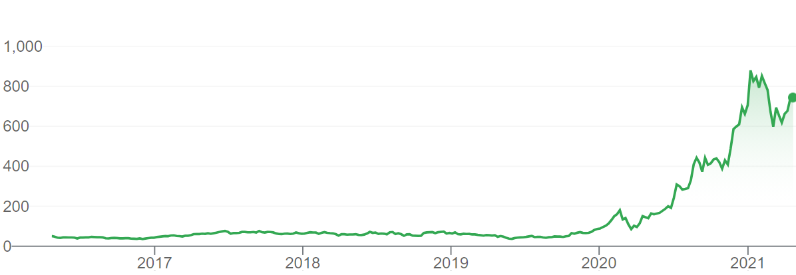
Stocks
WHY IS IT GOOD TO OWN A STOCK?
→ there may be growth in the value of the stock
that can be realized if you sell the given stock
BUT STOCKS ARE CONSIDERED TO BE
A RISKY INVESTMENT !!!

Slide 25
Stocks
WHY IS IT GOOD TO OWN A STOCK?
→ there may be growth in the value of the stock
that can be realized if you sell the given stock
BUT STOCKS ARE CONSIDERED TO BE
A RISKY INVESTMENT !!!
→ there are so-called dividends. These are payments paid
out every quarter or every six months to the shareholders
→ the amount of dividend usually depends on the
profitability of the given company

Slide 26
Stocks
MEASURING THE RISK OF STOCK - VOLATILITY
→ statistical measure of the dispersion of returns for a given security
which is the amount of uncertainty (or risk) about the size of changes
in the value of a given security (stock, bond etc.)
→ we can measure volatility with standard deviation
or variance between returns of the same security
HIGHER THE VOLATILITY THE RISKIER THE SECURITY !!!
→ we can use the Capital Asset Pricing Model (CAPM)
with the β value to approximate volatiliy

Slide 27
Commodities (Quantitative Finance)

Slide 28



Commodities
commodities are raw products such as gold, oil or natural gas
investin into commodities is not that simple
how to actually own a barrel of oil?
USUALLY COMMODITIES (SUCH AS OIL) ARE
EXTREMELY VOLATILE !!!
this is why there are future contracts

Slide 29
Commodities
WHY DO COMMODITY PRICES FLUCTUATE?
we can see that the S(t) commodity prices
are usually very similar
to a random walk
COMMODITY PRICES RISE AND FALL
DUE TO THE FLUCTUATION OF
SUPPLY AND DEMAND !!!
if more people want to buy a given commodity
then its market price will increase
S(t)
t

Slide 30
Commodities
futures contracts are made in an attempt by producers and suppliers of commodities to avoid market volatility
they negotiate the price of a given commodity in the future
„The major cost for airlines is fuel expenses.
So fluctuating oil prices can greatly impact airlines. This is why they use oil futures to protect them from rising oil prices”

Slide 31

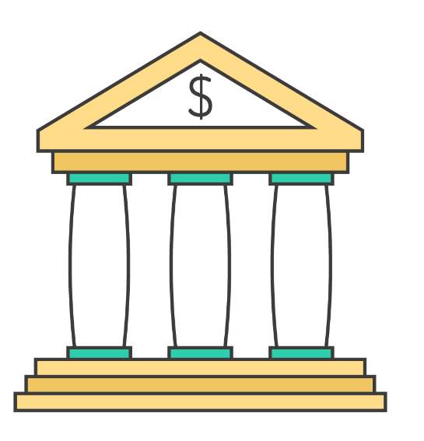



Commodities
the FUTURE MARKET is an auction
market in which participants buy and sell
commodity and futures contracts
(New York Mercantile Exchange)
investors use FUTURE BROKER FIRMS
that have the ability to buy
and sell commodities
there are several
commodities like gold, silver,
crude oil or natural gas
there are the investors
or companies that are looking
for commodities

Slide 32
Why Commodities are Useful?
commodities prices typically rise when inflation is accelerating
this is why commodities (oil or gold) usually offer protection from the effects of inflation
COMMODITIES MAY OFFER PROTECTION AGAINTS
THE NEGATIVE EFFECTS OF INFLATION !!!

Slide 33
Why Commodities are Useful?
if we can not invest into a commodity directly then we can invest into a company that relies on the given commodity
for example gold and shares of gold mines may be correlated
of course it may be affected by the company operating performance but usually there is a positive correlation
WE CAN USE PAIRS TRADING STRATEGY !!!

Slide 34
Currencies and the FOREX (Quantitative Finance)

Slide 35
Currencies and the FOREX
in finance an exchange rate is the rate at which one national currency will be exchanged for another
it tells you how much a given currency is worth in another currency
GOVERNMENTS AND CENTRAL BANKS CAN INFLUENCE
CURRENCIES AND EXCHANGE RATES !!!

Slide 36
Currencies and the FOREX
 | USA | EUR | GBP | CHF | CAD
USA | 1 | 0.741 | 0.657 | 1.061 | 1.011
EUR | 1.35 | 1 | 0.889 | 1.433 | 1.366
GBP | 1.521 | 1.126 | 1 | 1.614 | 1.538
CHF | 0.943 | 0.698 | 0.62 | 1 | 0.953
CAD | 0.955 | 0.732 | 0.65 | 1.049 | 1

Slide 37
Currencies and the FOREX
WHY DO EXCHANGE RATES FLUCTUATE?
we can see that the S(t) exchange rates
are usually very similar
to a random walk
EXCHANGE RATES RISE AND FALL
DUE TO THE FLUCTUATION OF
SUPPLY AND DEMAND !!!
if more people want to buy a given currency
then its market price will increase
S(t)
t

Slide 38
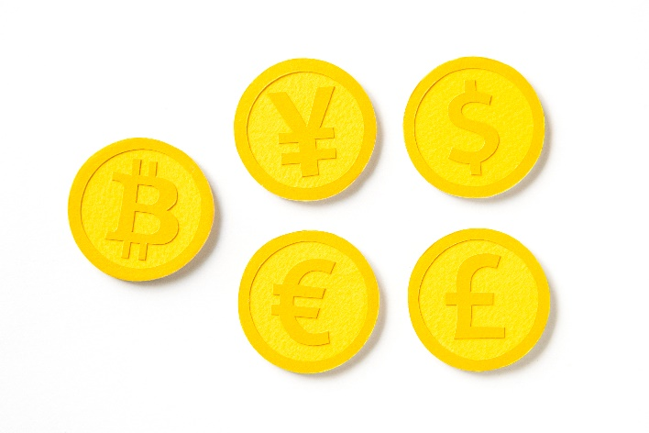
FOREX
the FOREX MARKET is the market
for trading international currencies
investors use FOREX BROKER
FIRMS that have the ability
to buy and sell currencies
there are several
currencies like USD, CAD,
YEN or GBP
there are several investors
that are looking for
international currencies

Slide 39
Factors Affecting Exchange Rates
– INTEREST RATES –
the interest rate is a major factor that can be manipulated by the
central bank of a country. Investors will lend money to the banks
of the given country for higher returns

Slide 40
Factors Affecting Exchange Rates
– INTEREST RATES –
the interest rate is a major factor that can be manipulated by the
central bank of a country. Investors will lend money to the banks
of the given country for higher returns
– MONEY SUPPLY –
the money supply created by the central bank by printing too much currency may trigger inflation. Investors do not like inflation so they
will leave the currency that can push the value of a currency down.

Slide 41
Factors Affecting Exchange Rates
– INTEREST RATES –
the interest rate is a major factor that can be manipulated by the
central bank of a country. Investors will lend money to the banks
of the given country for higher returns
– MONEY SUPPLY –
the money supply created by the central bank by printing too much currency may trigger inflation. Investors do not like inflation so they
will leave the currency that can push the value of a currency down.
– FINANCIAL STABILITY –
the financial stability and economic growth of a given country
have a huge impact on the value of the exchange rate

Slide 42
Arbitrage on the FOREX
We can construct a directed graph G(V,E) out of
the exchange rate table with V currencies
→ the V nodes of the graph are the currencies
→ the E edges are the relative values
We take the natural logarithm of the edges
and mutiply the edges by -1
We end up with a negative edge weighted G’(V,E)
Graph where the negative cycles are the
arbitrage opportunities
USD
GBP
EUR
CHF
CAD
WE CAN USE BELLMAN-FORD SHORTEST PATH ALGORITHM TO FIND NEGATIVE CYCLES IN O(V*E) RUNNING TIME !!!

Slide 43
Long and Short Positions (Quantitative Finance)

Slide 44
Long Position
long position in a security means that you own the security
investors maintain long positions in the expectation that the stock will increase in value in the future
S(t)
of course the investor can make
a profit in this case with a long position
because S(t_{T}) > S(t₀)
SO INVESTORS CAN MAKE A PROFIT
BY MAINTAINING A LONG POSITION !!!
t
t₀
t_{T}

Slide 45
Short Position
short position in a security means that you sell the security
investors maintain short positions in the expectation that the stock will decrease in value in the future
S(t)
of course the investor can make
a profit in this case with a short position
because S(t_{T}) < S(t₀)
SO INVESTORS CAN MAKE A PROFIT
BY MAINTAINING A SHORT POSITION !!!
short selling means you sell something
you do not actually own
t
t₀
t_{T}

Slide 46
Short Position
”Short-selling is when an investor borrows shares and immediately sells them – hoping he can buy them up later at a lower price return them to the lender and pocket the difference”

Slide 47
Risks with Short and Long Positions
shorting is much riskier than opening long positions
when you open long position then your maximum possible loss is 100% so you may lose your entire initial investment
with short selling there is no limit to how much you can lose
because there is no limit for the given stock to increase in value

Slide 48


Bearish and Bullish Markets
a bear market is when the market experiences
stable price declines
→ so when securities fall for a sustained period of time
SO THIS IS WHEN WE CAN MAKE A PROFIT WITH SHORT POSITIONS
a bull market is when the market experiences
stable price increase
→ so when securities are on the rise for a sustained period of time
SO THIS IS WHEN WE CAN MAKE A PROFIT WITH LONG POSITIONS

Slide 49
Bonds (Quantitative Finance)

Slide 50
Bonds
A bond is a debt investment in which an investor loans
money to an entity (company or government)

Slide 51
Bonds
A bond is a debt investment in which an investor loans money to
an entity (company or government)
→ for a defined period of time
→ variable or fixed interest rate
BONDS ARE FIXED-INCOME SECURITIES !!!
So when a company needs to raise money to finance new projects they
may issue bonds directly to investors instead of obtaining loans form bank
→ interest rate of bonds are usually a bit higher
than that of the banks

Slide 52
Bonds
There are 2 main types of bonds:

Slide 53
Bonds
There are 2 main types of bonds:
zero-coupon bonds

Slide 54
Bonds
There are 2 main types of bonds:
zero-coupon bonds
coupon bonds

Slide 55
Zero-Coupon Bonds
$1000
10% rate
2 years

Slide 56
Zero-Coupon Bonds
this is the principal amount and
there are several synonyms
(par value, face value or nominal value)
THE PRINCIPAL AMOUNT IS PAID TO THE INVESTOR AFTER A SPECIFIED PERIOD OF TIME !!!
it is crucial that when dealing with
zero-coupon bonds no other
cash payment is made
$1000
10% rate
2 years

Slide 57
Zero-Coupon Bonds
$1000
this is the premium (interest rate)
the bond issuer is willing to pay to
the investor for the loan
10% rate
2 years

Slide 58
Zero-Coupon Bonds
$1000
10% rate
this is the maturity date
IT DEFINES THE END OF
THE AGREEMENT
at this time the bond issuer
redeems the bond by
paying the principal
2 years

Slide 59
Zero-Coupon Bonds
t=0
t=1
t=2
on our example this is the
maturity date (T) when the bond issuer
pays the principal amount

Slide 60
Zero-Coupon Bonds
$1000
t=0
t=1
t=2
on our example this is the
maturity date (T) when the bond issuer
pays the principal amount

Slide 61
Zero-Coupon Bonds
$1000
< $1000
t=0
t=1
t=2
on our example this is the
maturity date (T) when the bond issuer
pays the principal amount

Slide 62

Zero-Coupon Bonds
HOW MUCH WOULD YOU PAY FOR THIS BOND?
of course it has something to
do with the present value of the
actual principal amount
$1000
10% rate
2 years
$$\frac{x}{\left(1+r\right) }$$
n

Slide 63
Zero-Coupon Bonds
HOW MUCH WOULD YOU PAY FOR THIS BOND?
of course it has something to
do with the present value of the
actual principal amount
$1000
10% rate
2 years
$$\frac{x}{\left(1+r\right) }$$
n
note that this is
the market interest rate

Slide 64

Zero-Coupon Bonds
HOW MUCH WOULD YOU PAY FOR THIS BOND?
of course it has something to
do with the present value of the
actual principal amount
$1000
10% rate
2 years
$$\frac{1000}{\left(1+0.04\right) }$$
2

Slide 65
Zero-Coupon Bonds
HOW MUCH WOULD YOU PAY FOR THIS BOND?
of course it has something to
do with the present value of the
actual principal amount
$1000
10% rate
2 years
$$\frac{1000}{\left(1+0.04\right) }$$
2

Slide 66
Zero-Coupon Bonds
$1000
$924
t=0
t=1
t=2
on our example this is the
maturity date (T) when the bond issuer
pays the principal amount

Slide 67
Zero-Coupon Bonds
$1000
$924
t=0
t=1
t=2
on our example this is the
maturity date (T) when the bond issuer
pays the principal amount

Slide 68
Coupon Bonds
$1000
10% coupon
3 years

Slide 69
Coupon Bonds
this is the principal amount and
there are several synonyms
(par value, face value or nominal value)
THE PRINCIPAL AMOUNT IS PAID TO THE INVESTOR AFTER A SPECIFIED PERIOD OF TIME !!!
it is crucial that when dealing with
zero-coupon bonds no other
cash payment is made
$1000
10% coupon
3 years

Slide 70
Coupon Bonds
a coupon rate is stated as a
nominal percentage of the principal
amount of the given coupon bond
THE RATE OF INTEREST THE BOND PAYS ANNUALLY !!!
each coupon is redeemable
per period for that percentage
$1000
10% coupon
3 years

Slide 71
Coupon Bonds
$1000
this is the maturity date
IT DEFINES THE END OF
THE AGREEMENT
at this time the bond issuer
redeems the bond by
paying the principal
10% coupon
3 years

Slide 72
Coupon Bonds
t=0
t=1
t=2
t=3
on our example this is the
maturity date (T) when the bond issuer
pays the principal amount

Slide 73
Coupon Bonds
$1100
$100
$100
t=0
t=1
t=2
t=3
on our example this is the
maturity date (T) when the bond issuer
pays the principal amount

Slide 74
Coupon Bonds
HOW MUCH WOULD YOU PAY FOR THIS BOND?
of course it has something to
do with the present value of the
actual principal amount
+ we have to deal
with the annual coupon
payments as well
$1000
10% coupon
3 years

Slide 75
Coupon Bonds
$1100
$100
$100
t=0
t=1
t=2
t=3

Slide 76
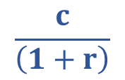
Coupon Bonds
$1100
$100
$100
t=0
t=1
t=2
t=3
$$\frac{c}{\left(1+r\right)}$$

Slide 77
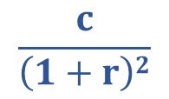
Coupon Bonds
$1100
$100
$100
t=0
t=1
t=2
t=3
$$\frac{c}{\left(1+r\right)2}$$

Slide 78
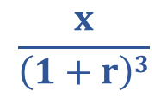

Coupon Bonds
$1100
$100
$100
t=0
t=1
t=2
t=3
$$\frac{c}{\left(1+r\right)3}$$
+
$$\frac{x}{\left(1+r\right)3}$$

Slide 79
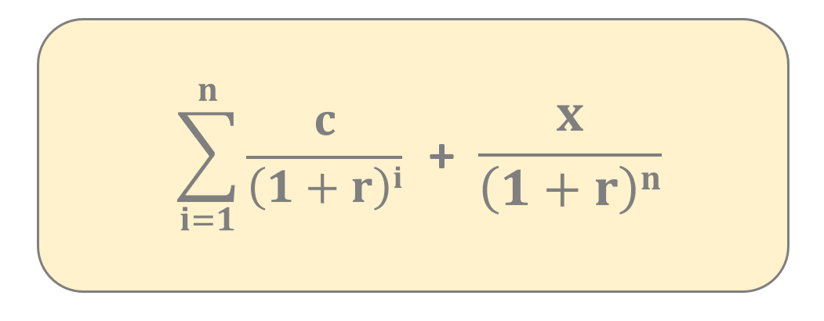
Coupon Bonds
we have to calculate the
present value of the
principal amount
when we calculate the present
value we always use the
market interest rate
we have to calculate the
present value of the
coupon payments

Slide 80
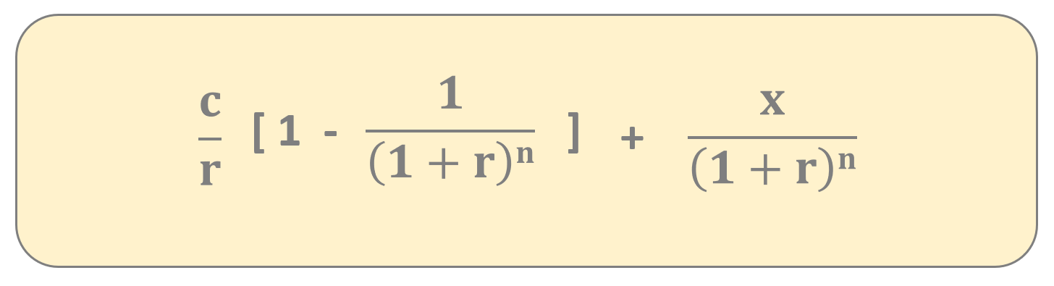
Coupon Bonds
we have to calculate the
present value of the
principal amount
when we calculate the present
value we always use the
market interest rate
we have to calculate the
present value of the
coupon payments

Slide 81
Coupon Bonds
$1100
$1167
$100
$100
t=0
t=1
t=2
t=3
so this is how we can calculate the price
of zero-coupon and coupon bonds
WE HAVE TO USE THE PRESENT VALUE OF THE PAYMENTS + PRINCIPAL !!!

Slide 82
Yield to Maturity (YTM) (Quantitative Finance)

Slide 83

Yield
yield is a figure that shows the return you get on a bond
we can caculate it with a simple formula
it defines how much money your investment is generating
$$\frac{annual coupon amount}{bond price}$$

Slide 84
Yield to Maturity
The yield to maturity of a bond is the internal rate of return (overall interest rate) earned
by an investor who buys the bond at t (today) at V market price
we assume that the bond is held until T maturity
all C_{i} coupon and P principal payments are made on schedule

Slide 85
Yield to Maturity
The yield to maturity of a bond is the internal rate of return (overall interest rate) earned
by an investor who buys the bond at t (today) at V market price
we assume that the bond is held until T maturity
all C_{i} coupon and P principal payments are made on schedule
P
V
„It is the y interest rate that
will make the present value
of the cash flows from the
investment equal to the
price (or cost) of the investment”
C_{i}
C_{i}
t
T

Slide 86
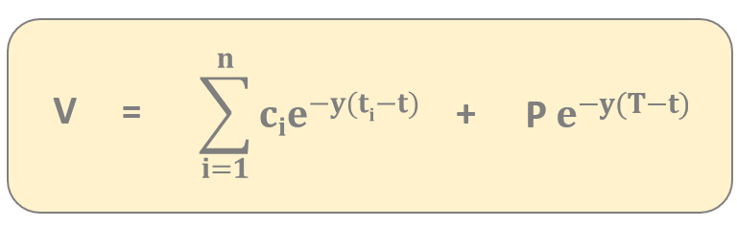
Yield to Maturity
we have to calculate the P
present value of the
principal amount
discounting everything
back to the t present
gives the current V price
we have to calculate the
present value of the
c_{i} coupon payments

Slide 87


Yield to Maturity
solve numerically
for y
$$\sum_{i=1}^{n}{cie^{−y(ti−t)} }$$
V =
+
P $e^{−y(T−t)}$

Slide 88
Yield Curve
of course longer bonds pay investors higher
interest rates – investors expect more yield in return
for loaning their money for a longer period of time
BECAUSE LONG-TERM BONDS POSE MORE RISK THAN SHORT-TERM BONDS
for example a more attractive investment
may arise or negative effects
may impact the bonds
yield (%)
time to
maturity (years)

Slide 89
Bonds Prices and Market Interested Rates
bonds and market interest rates are negatively correlated
when the cost of borrowing money rises bond
prices usually fall and vice-versa
THIS IS WHY THE MARKET INTEREST RATE IS SO IMPORTANT (IN MONETARY POLICY) !!!
of course if the market interest rate is high
enough than it is better to lend money to the bank
rather than buying bonds
bond price
(value)
market
interest rate

Slide 90


Macaulay Duration
Macaulay duration is a measure of how long it takes for the price of a bond to be repaid by the cash flows from it
it is the time an investor would take to get back all his invested money in the bond by the periodic interest as well as principal repayments
bond price
(value)
- $\frac{1}{V}$ $\frac{dV}{dy}$
for zero coupon
bonds the Macaulay
duration is the
same as the T time
to maturity
$$\frac{dV}{dy}$$
yield to
maturity

Slide 91


Macaulay Duration
bond prices and interest rates are negatively correlated
bonds with longer T maturity periods are more sensitive to changes in market interest rates than a bonds with short durations
the market interest rate increases which means
the bonds price may fall dramatically
T = 10 years
T = 4 years

Slide 92
Macaulay Duration
bond prices and interest rates are negatively correlated
bonds with longer T maturity periods are more sensitive to changes in market interest rates than a bonds with short durations
MACAULAY DURATION DEFINES HOW SENSITIVE THE BOND PRICE IS TO THE LITTLE CHANGE IN THE MARKET INTEREST RATE
investors prefer bonds with longer maturity when interest rates are expected to fall (and go down)
investors prefer bonds with short maturity when interest rates are either likely to go up or stay stable

Slide 93
Risks Associated with Bonds
INTEREST-RATE RISK
bond price moves in the opposite direction
to changes in interest rate

Slide 94
Risks Associated with Bonds
INTEREST-RATE RISK
bond price moves in the opposite direction
to changes in interest rate
DEFAULT RISK
the risk that the bond issuer may be unable to make
principal and coupon payments on time

Slide 95
Risks Associated with Bonds
INTEREST-RATE RISK
bond price moves in the opposite direction
to changes in interest rate
DEFAULT RISK
the risk that the bond issuer may be unable to make
principal and coupon payments on time
INFLATION RISK
this risk is caused by variations in the value of cash flows due to inflation as measured in terms of purchasing power

Slide 96
Stocks and Bonds
STOCKS
stocks are shares in
the ownership of a business
the holders of stock can vote on
certain company issues
a company has the option to
reward its shareholders
with dividends
stocks are riskier investments
than bonds
BONDS
bonds are a form of debt that the
issuing entity promises to repay at
some point in the future
bond holders have no
voting rights
no dividends
bonds are considered to be
safe investments

Slide 97
Numerical Measures (Quantitative Finance)

Slide 98



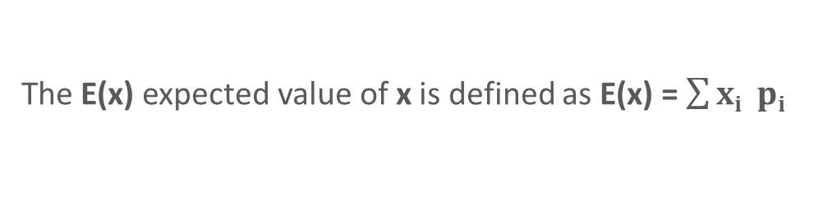



Statistics
The mean or expected value E(x) of an x random variable is
the mean average value in the population
E(x) = μ „expected value”
Let x be a random variable with a finite number of finite outcomes
x₁ x₂ ... x_{k} occuring with probabilities p₁ p₂ ... p_{k}
The E(x) expected value of x is defined as E(x) = $\sum{xi pi}$
i
EXAMPLE: x is the outcome of a roll of a die. The outcomes can be
{1,2,3,4,5,6}. The E(x) expected value of x is:
$$\frac{1}{6}$$
$$\frac{1}{6}$$
$$\frac{1}{6}$$
$$\frac{1}{6}$$
$$\frac{1}{6}$$
$$\frac{1}{6}$$
E(x) = 1 + 2 + 3 + 4 + 5 + 6 = 3.5

Slide 99
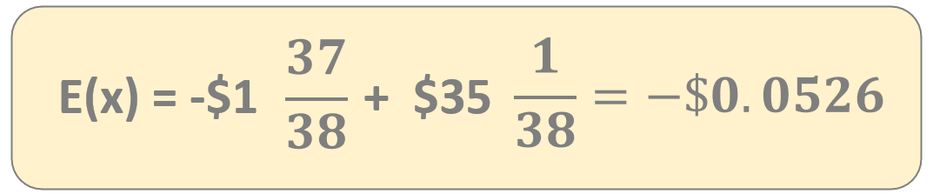
Statistics
The roulette game consists of a wheel with 38 numbered pockets.
Let x represents the outcome of $1 on a single number.
x: amount of money we win/lose
amount of
money if
you lose
amount of
money if
you win

Slide 100
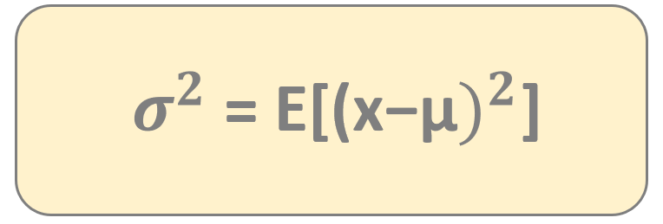
Statistics
The variance of an x random variable is the expected value
of the squared deviations of variables from the mean
The variance is always positive: we can define the
σ standard deviation as the square root of variance

Slide 101
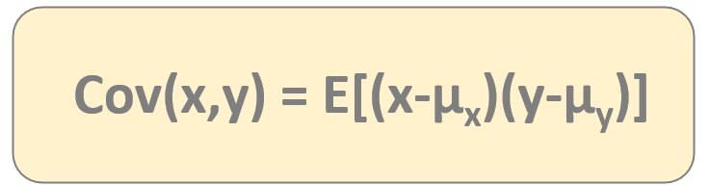
Statistics
The covariance of an x and y is a measure of the
joint variability of two random variables
covariance defines how two
variables move together
There is one issue when dealing with covariance:
→ it is a dimensional measure
→ it is not normalized so it is hard to compare
datasets with large differences in spread
THIS IS WHY CORRELATION IS PREFERRED !!!

Slide 102
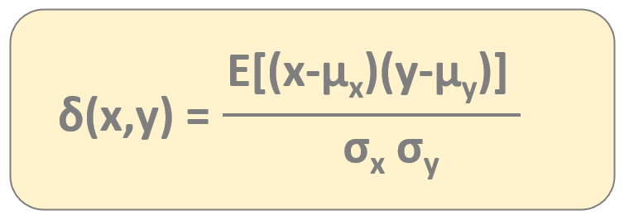
Statistics
The correlation is a dimensionless measure of how two random
variables vary together
the correlation
value is alway within
the range [-1,1]
δ(x,y) > 0 positive linear relationship between variables
δ(x,y) = 0 no relationship between variables
δ(x,y) < 0 negative linear relationship

Slide 103
Modern Portfolio Theory (Quantitative Finance)

Slide 104
Modern Portfolio Theory
it was first formulated by Harry Markowitz back in 1952
he was later awarded with the Nobel prize in economics
it is a portfolio optimization model
it assists in the selection of the most efficient portfolio by considering various possible portfolios of the given securities based on expected return (mean) and risk (variance)
A portfolio is a collection of financial investments
such as stocks, bonds, commodities and cash

Slide 105
Modern Portfolio Theory
WHAT IS THE MAIN IDEA BEHIND MARKOWITZ-MODEL?
if we invest all of our money
into a single stock then we take
a huge risk because stock
are volatile
A SINGLE STOCK IS QUITE RISKY – BECAUSE IT IS UNPREDICTABLE !!!
we do not know for certain whether the
S(t) stock price will rise or fall
S(t)
t

Slide 106
Modern Portfolio Theory
WHAT IS THE MAIN IDEA BEHIND MARKOWITZ-MODEL?
we may combine multiple assets (stocks) in order
to reduce risk as much as possible
this is the main conclusion
of Markowitz-model
THIS IS CALLED DIVERZIFICATION !!!
combining assets is the main idea
and this is the same approach with
Black-Scholes model

Slide 107
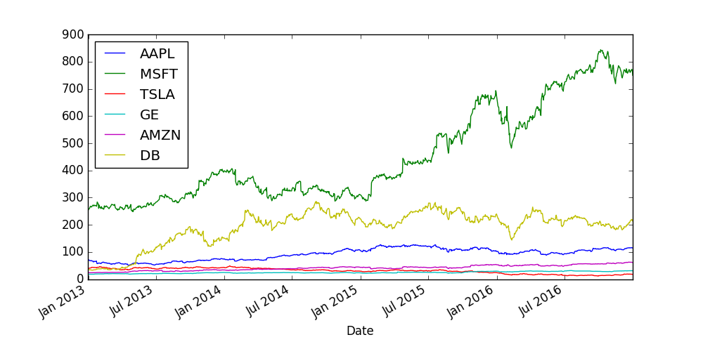
Modern Portfolio Theory
WHAT IS THE MAIN IDEA BEHIND MARKOWITZ-MODEL?

Slide 108
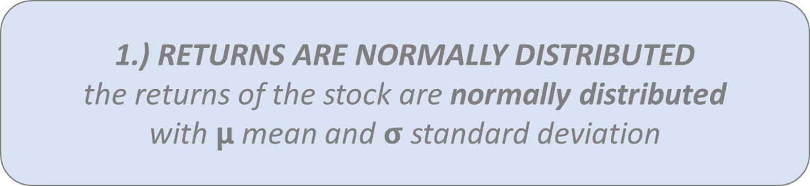
Modern Portfolio Theory
ASSUMPTIONS OF THE MARKOWITZ-MODEL
1.) RETURNS ARE NORMALLY DISTRIBUTED
the returns of the stock are normally distributed
with $μ$ mean and $σ$standard deviation

Slide 109
Modern Portfolio Theory
ASSUMPTIONS OF THE MARKOWITZ-MODEL
1.) RETURNS ARE NORMALLY DISTRIBUTED
the returns of the stock are normally distributed
with $μ$ mean and $σ$standard deviation
2.) INVESTORS ARE RISK-AVERSE
investors will take on more risk if they
are expecting more return

Slide 110
Modern Portfolio Theory
if there is a low risk (bonds) the return is low as well
with higher risk (stocks) the returns are usually higher
modern portfolio theory states that investors can construct optimal portfolios offering the maximum possible expected return for a given level of risk
SO THE EFFICIENT PORTFOLIO IS THE PORTFOLIO THAT
HAS THE HIGHEST REWARD FOR A GIVEN LEVEL OF RISK
OR THE LOWEST RISK FOR A GIVEN RETURN !!!

Slide 111
Modern Portfolio Theory
The investors are not allowed to set up short positions in a security so
100% of the wealth has to be divided among available assets (stocks) in a
way that all positions are long positions

Slide 112
Modern Portfolio Theory
The investors are not allowed to set up short positions in a security so
100% of the wealth has to be divided among available assets (stocks) in a
way that all positions are long positions
AAPL
20%
GOOGL
30%
TSLA
25%
GE
25%
weights = [0.2, 0.3, 0.25, 0.25]

Slide 113
Modern Portfolio Theory
The investors are not allowed to set up short positions in a security so
100% of the wealth has to be divided among available assets (stocks) in a
way that all positions are long positions
AAPL
20%
GOOGL
30%
TSLA
25%
GE
25%
weights = [0.2, 0.3, 0.25, 0.25]
We have to make sure the sum of weights is 1 because 100%
of the investor’s wealth is divided among the available assets

Slide 114
Modern Portfolio Theory
w_{i}
r_{i}
μ_{i}
this is the weight for
the i-th asset or stock
this is the return for
the i-th asset or stock
(historical data)
this is the expected return for
the i-th asset or stock
(mean of the returns)

Slide 115

Modern Portfolio Theory
$$\frac{S\left(t+1\right)−S(t)}{S(t)}$$
S(t)
this is how we can calculate
the daily return of a given stock
DAILY RETURN FOR A GIVEN STOCK !!!
we have to consider neighboring
[t,t+1] time steps
t
t
t+1

Slide 116


Modern Portfolio Theory
$$\frac{S\left(t+1\right)}{S(t)}$$
S(t)
$$ln$$
usually we use the logarithm
of the returns because
of mathematical convenience
LOG DAILY RETURNS ARE MORE POPULAR !!!
we have to consider neighboring
[t,t+1] time steps
t
t
t+1

Slide 117
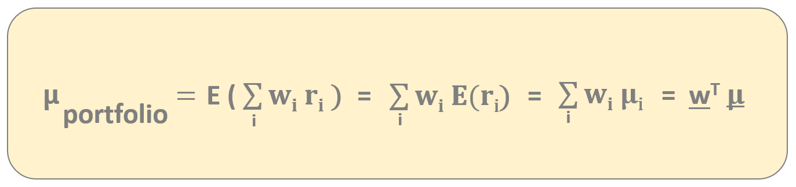
Modern Portfolio Theory
This model relies heavily on historical data – historical mean performance
is assumed to be the best estimator for future (expected) performance
EXPECTED RETURN OF THE PORTFOLIO !!!

Slide 118
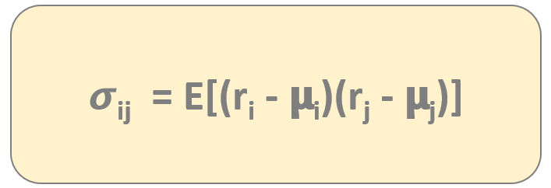
Modern Portfolio Theory
The risk of the portfolio can be measured by the volatility – that can be approximated
by the standard deviation or the variance
covariance defines how two
variables move together
𝞂_{ij} < 0 negative covariance means returns move inversely
𝞂_{ij} > 0 positive covariance means that asset returns move together
COVARIANCE IS CRUCIAL IN PORTFOLIO THEORY !!!

Slide 119
Modern Portfolio Theory
Markowit’z model is about diverzification which means we want to reduce risk as much as possible
possessing assets (such as stocks) with high positive σ_{ij} covariance does not provide much diverzification
the aim of diversification is to eliminate fluctuations in the long term
WE SHOULD INCLUDE UNCORRELATED STOCKS
IN THE PORTFOLIO INSTEAD !!!

Slide 120
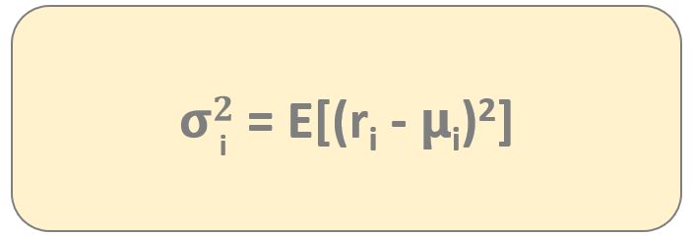
Modern Portfolio Theory
The risk of the portfolio can be measured by the volatility – that can be approximated
by the standard deviation or the variance
variance is the covariance
of variable with itself
For calculating the variance of the portfolio we need the
covariance matrix containing all the covariances
of the stocks involved in the portfolio !!!

Slide 121
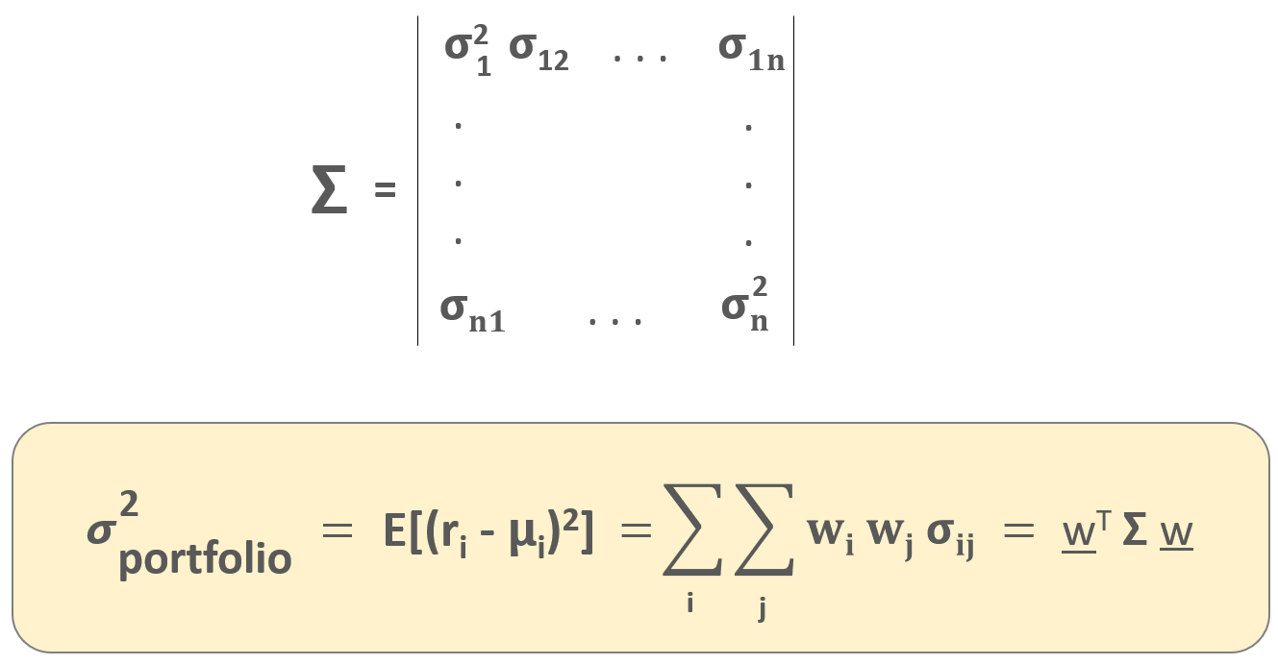
Modern Portfolio Theory
this covariance matrix
contains the relationship
between all the assets
(in this case stocks)
in the portfolio
EXPECTED PORTFOLIO VARIANCE !!!

Slide 122
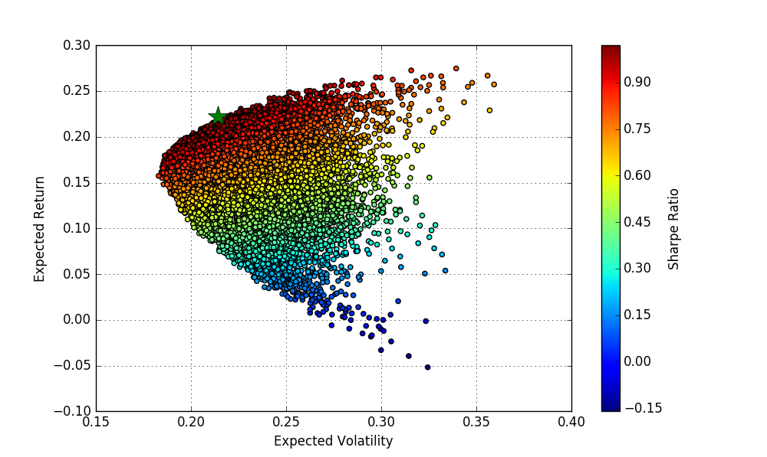
Modern Portfolio Theory
the dots represent different w
weights of a given portfolio containing
multiple stocks (so different portfolios)
An investor is interested in:
1.) the maximum return (mean) given a fixed
risk level (so volatility)
2.) minimum risk given a fixed return
These portfolios make up the so-called „efficient-frontier”
This is the main feature of Markowitz model the investor
can decide the risk or the expected return
IF YOU WANT TO MAKE MONEY, YOU HAVE TO TAKE RISK !!!

Slide 123
Modern Portfolio Theory
A
B
RETURN
C
D
RISK

Slide 124
Modern Portfolio Theory
RETURN
RISK

Slide 125
Modern Portfolio Theory
RETURN
RISK

Slide 126
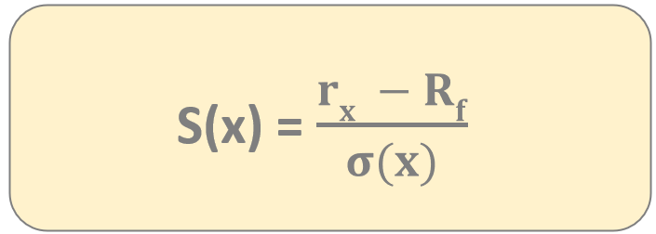
Sharpe Ratio
It is one of the most important risk and return measures used in
quantitative finance – it was first used by William Sharpe
It describes how much excess return you are receiving
for extra volatility that you endure holding a riskier asset (stock)
a Sharpe-ratio S(x) > 1
is considered to be good
r_{x}
average rate of return of investment x
R_{f}
rate of return of risk-free security

Slide 127
Capital Allocation Line
usually there are not just stocks
in out portfolio – we can consider
bonds and risk-free assets as well
WE CAN HAVE RISK-FREE ASSETS IN OUR PORTFOLIO AS WELL !!!
considering this fact what is the
optimal portfolio now?
the optimal portfolios lie on the
capital allocation line
this is the capital
allocation line
RETURN
portfolio with
maximum Sharpe-ratio
risk-free
asset
RISK

Slide 128
Monte-Carlo Simulations (Quantitative Finance)

Slide 129
Monte-Carlo Simulations
this method was first used back in the 1940s during the Manhattan Project at Los Alamos
John von Neumann, Stanislaw Ulam and Nicholas Metropolis applied this method to nuclear physics related problems
Monte-Carlo method solves a deterministic
problem using probabilistic methods

Slide 130
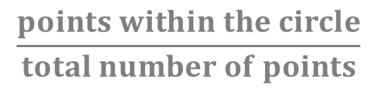
Monte-Carlo Simulations
for example we have to calculate the
area of the circle within a square
WE CAN GENERATE RANDOM POINTS
ON THE TWO-DIMENSIONAL PLANE
we just have to count the relative frequency
of points inside the circle
a
a
A_{circle} = a²
$$\frac{points within the circle}{total number of points}$$

Slide 131
Monte-Carlo Simulations
WHAT IS THE BASIC PRINCIPLE?
we can estimate the possible outcomes of an uncertain events
have to generate several possible outcomes and then we have to calculate the average of these outcomes
the more iterations we make the better will be the prediction

Slide 132
Monte-Carlo Simulations
dS = 𝝻 S dt + 𝞂 S dX
we know that S(t) assets (such as stocks)
follow lognormal random work
IF WE KNOW THE S(0) STARTING POINT OF THE STOCK PRICE AND WE KNOW THE 𝝻 and 𝞂 PARAMETERS
THEN WE CAN MAKE MULTIPLE SIMULATIONS
it is quite cheap to create simulations like these we know
how to simulate lognormal random walks
THE AVERAGE OF THESE SIMULATIONS YIELDS THE FUTURE S(t) PRICE OF THE STOCK !!!

Slide 133
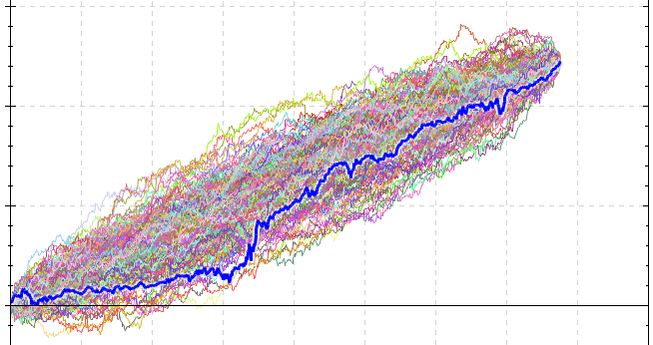
Monte-Carlo Simulations

Slide 134
Collateralized Debt Obligations – CDOs – (Quantitative Finance)

Slide 135
Collateralized Debt Obligations (CDOs)
CDOs were first constructed back in 1987 by bankers at Drexel Burnham Lambert Inc.
within 10 years CDOs have been the major force in the market
a collateralized debt obligation is a complex structured-finance product that is backed by a pool of loans and other assets
according to Warren Buffet CDOs and other derivatives are financial weapons of mass destruction

Slide 136

Collateralized Debt Obligations (CDOs)
a given commercial bank
can issue and approve several
types of loans
STUDENT LOANS
around 65% of students took out loans and
they graduate with an average debt of $30k

Slide 137
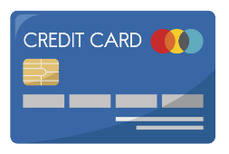
Collateralized Debt Obligations (CDOs)
a given commercial bank
can issue and approve several
types of loans
STUDENT LOANS
around 65% of students took out loans and
they graduate with an average debt of $30k
CREDIT CARD LOANS
the average credit card debt of families
in the US is around $6000

Slide 138

Collateralized Debt Obligations (CDOs)
a given commercial bank
can issue and approve several
types of loans
MORTGAGE
around 60% of the homeowners have
mortgage debt in the US

Slide 139

Collateralized Debt Obligations (CDOs)
a given commercial bank
can issue and approve several
types of loans
MORTGAGE
around 60% of the homeowners have
mortgage debt in the US
CAR LOANS
there are around 100 million car loan
accounts in the US

Slide 140
Collateralized Debt Obligations (CDOs)
a given commercial bank
can issue and approve several
types of loans
investment banks buy these
loans and create a financial product
called CDO

Slide 141
Collateralized Debt Obligations (CDOs)
a given commercial bank
can issue and approve several
types of loans
INVESTMENT BANKS SELL THESE CDOS TO INVESTORS SEEKING FOR HIGHER
RETURN THAN TREASURY BILLS OR BONDS !!!
investment banks buy these
loans and create a financial product
called CDO

Slide 142
Collateralized Debt Obligations and Diverzification (Quantitative Finance)

Slide 143
Collateralized Debt Obligations (CDOs)
CDO
MORTGAGE #1
STUDENT LOAN #2
CAR LOAN #1
MORTGAGE #2
STUDENT LOAN #1
CAR LOAN #2

Slide 144
Collateralized Debt Obligations (CDOs)
CDO
DEFAULT
MORTGAGE #1
STUDENT LOAN #2
CAR LOAN #1
MORTGAGE #2
STUDENT LOAN #1
CAR LOAN #2

Slide 145
Collateralized Debt Obligations (CDOs)
CDO
DEFAULT
MORTGAGE #1
STUDENT LOAN #2
DEFAULT
CAR LOAN #1
MORTGAGE #2
STUDENT LOAN #1
CAR LOAN #2

Slide 146
Collateralized Debt Obligations (CDOs)
diverzification is an extremely crucial factor in credit derivatives as well – this is one of the key principles of finance
a given CDO should contain different assets (bonds and different loans) that are uncorrelated
WE SHOULD INCLUDE AS MANY UNCORRELATED ASSETS IN
CREDIT DERIVATIVES AS POSSIBLE !!!
possessing assets with high positive σ_{ij} covariance does not provide much diverzification
the aim of diversification is to eliminate fluctuations in the long term

Slide 147
Collateralized Debt Obligations (CDOs)
CDO
MORTGAGE #1
STUDENT LOAN #2
CAR LOAN #1
MORTGAGE #2
STUDENT LOAN #1
CAR LOAN #2

Slide 148
Collateralized Debt Obligations (CDOs)
CDO
MORTGAGE #1
STUDENT LOAN #1
MORTGAGE #2
MORTGAGE #5
MORTGAGE #3
MORTGAGE #4

Slide 149
CDO Tranches (Quantitative Finance)

Slide 150
Collateralized Debt Obligations (CDOs)
CDO

Slide 151
Collateralized Debt Obligations (CDOs)
SENIOR TRANCHE
this is the safest tranche of the CDO
which means it gives lower return (4%) but of course
the risk is lower as well
this tranche gets the payouts first
coming from the loans
SAFEST TRANCHE OF THE CDO !!!
AAA rating by credit rating agencies
(such as Standard & Poors or Moody’s)

Slide 152
Collateralized Debt Obligations (CDOs)
JUNIOR TRANCHE
this is a bit riskier layer of the CDO
which means it gives higher return (7%) but of course
the risk is higher as well
this tranche gets the payouts
coming from the loans after the senior tranche
IT IS CONSIDERED TO BE A RELATIVELY SAFEST
TRANCHE OF THE CDO !!!
BBB rating by credit rating agencies
(such as Standard & Poors or Moody’s)

Slide 153
Collateralized Debt Obligations (CDOs)
RISKY TRANCHE
this is quite a risky layer of the CDO
which means it gives higher return (10%) but of course
the risk is higher as well
this tranche gets the payouts last
coming from the loans
IT IS CONSIDERED TO BE A RISKY INVESTMENT
SO USUALLY HEDGE FUNDS BUY THIS TRANCHE !!!

Slide 154
Collateralized Debt Obligations (CDOs)
RISKY TRANCHE
this is quite a risky layer of the CDO
which means it gives higher return (10%) but of course
the risk is higher as well
this tranche gets the payouts last
coming from the loans
IT IS CONSIDERED TO BE A RISKY INVESTMENT
SO USUALLY HEDGE FUNDS BUY THIS TRANCHE !!!

Slide 155
Financial Crisis of 2008 (Quantitative Finance)

Slide 156
Collateralized Debt Obligations (CDOs)
this system was working extremely fine for everyone – commercial banks, investment banks and for the investors as well
there was a need for more loans and mortgages to be able to sell more CDOs

Slide 157
Collateralized Debt Obligations (CDOs)
this system was working extremely fine for everyone – commercial banks, investment banks and for the investors as well
there was a need for more loans and mortgages to be able to sell more CDOs
THIS IS WHY SUB-PRIME
MORTGAGES CAME TO BE !!!

Slide 158
Collateralized Debt Obligations (CDOs)
if the homeowners defaulted on their mortgage then the lender (bank) gets the house
and usually house prices are increasing
this is why lenders can add more risk to new mortgages

Slide 159
Collateralized Debt Obligations (CDOs)
if the homeowners defaulted on their mortgage then the lender (bank) gets the house
and usually house prices are increasing
this is why lenders can add more risk to new mortgages
A subprime mortgage is a type of loan granted to individuals with poor credit scores who would not qualify for conventional mortgages

Slide 160
Collateralized Debt Obligations (CDOs)
CDO
MORTGAGE #1
STUDENT LOAN #1
DEFAULT
MORTGAGE #2
MORTGAGE #5
MORTGAGE #3
MORTGAGE #4

Slide 161
Collateralized Debt Obligations (CDOs)
CDO
MORTGAGE #1
STUDENT LOAN #1
DEFAULT
DEFAULT
MORTGAGE #2
MORTGAGE #5
MORTGAGE #3
MORTGAGE #4

Slide 162
Collateralized Debt Obligations (CDOs)
CDO
MORTGAGE #1
STUDENT LOAN #1
DEFAULT
DEFAULT
MORTGAGE #2
DEFAULT
MORTGAGE #5
MORTGAGE #3
MORTGAGE #4

Slide 163
Collateralized Debt Obligations (CDOs)
because of sub-prime
mortgages there was
a huge probability of default
+ CDO assets were
highly correlated !!!
because of the huge probability
of default the investors
did not get the payments
INVESTORS BOUGHT AAA ASSETS BUT THEY HAVE DEFAULTED !!!
DEFAULT
MORTGAGE #3
most of the commercial banks
and investment banks were using leverage
(so used loans)
EVERYBODY WENT BANKRUPT !!!
investors do not want to invest into CDOs
anymore and the whole system froze

Slide 164
Risks in Finance (Quantitative Finance)

Slide 165
Risks in Finance
holding just a single stock is quite risky
we should hold a portfolio of stocks to reduce risk – this is what we can optimize with the Markowitz-model

Slide 166
Risks in Finance
holding just a single stock is quite risky
we should hold a portfolio of stocks to reduce risk – this is what we can optimize with the Markowitz-model
BUT UNFORTUNATELY WE CAN NOT GET RID OF
ALL THE RISKS WHEN BUYING MULTIPLE STOCKS !!!

Slide 167
Risks in Finance
– UNSYSTEMATIC (SPECIFIC) RISK –
This is the risk specific to individual stocks. It can be diverzified away by holding multiple stocks in a portfolio. Unsystematic risk is the component of a stock’s return that is not correlated with market moves.

Slide 168
Risks in Finance
– UNSYSTEMATIC (SPECIFIC) RISK –
This is the risk specific to individual stocks. It can be diverzified away by holding multiple stocks in a portfolio. Unsystematic risk is the component of a stock’s return that is not correlated with market moves.
– SYSTEMATIC (MARKET) RISK –
This risk can not be diverzified away. This is the risk because of
interest rate changes, recessions or wars. The CAPM model measures
this risk with the β parameter.

Slide 169
Capital Asset Pricing Model (CAPM) (Quantitative Finance)

Slide 170
Capital Asset Pricing Model (CAPM)
the Capital Asset Pricing Model (CAPM) was first formulated by William F. Sharpe back in the early 1960s
linear relationship between any stock expected return and the market premium

Slide 171
Capital Asset Pricing Model (CAPM)
expected return of investment – it may be a single stock or a portfolio
E[r_{a}] = r_{f} + β_{a} ( E[r_{m}] – r_{f} )

Slide 172
Capital Asset Pricing Model (CAPM)
expected return of investment – it may be a single stock or a portfolio
E[r_{a}] = r_{f} + β_{a} ( E[r_{m}] – r_{f} )
base return
because of
risk-free rate

Slide 173
Capital Asset Pricing Model (CAPM)
expected return of investment – it may be a single stock or a portfolio
E[r_{a}] = r_{f} + β_{a} ( E[r_{m}] – r_{f} )
base return
because of
risk-free rate
market excess return or the market premium multipled by a factor

Slide 174
Capital Asset Pricing Model (CAPM)
expected return of investment – it may be a single stock or a portfolio
E[r_{a}] = r_{f} + β_{a} ( E[r_{m}] – r_{f} )
base return
because of
risk-free rate
market excess return or the market premium multipled by a factor
LINEAR RELATIONSHIP BETWEEN ANY STOCK
EXPECTED RETURN AND MARKET PREMIUM !!!
(we can use S&P500 index as the market)

Slide 175
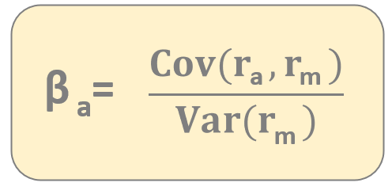
Capital Asset Pricing Model (CAPM)
the parameter defines how risky
your portfolio relative to the market
according to Capital Asset Pricing Model (CAPM) the β parameter is the
only relevant measure of a stock’s risk
the β parameter measures the stock’s relative volatility – how much the
price of a given stock goes up or down compared to that of the whole market

Slide 176
Capital Asset Pricing Model (CAPM)
the parameter defines how risky
your portfolio relative to the market
→ if your portfolio has no risk then your expected return is the
risk-free return (you can lend your money to a bank or government)
→ your portfolio is more risky than the market then your return
will be higher of course
→ your portfolio less risky than the market – less return
β = 1 stock moving exactly with the market has beta 1
β > 1 given stock is more volatile than the market (more expected return)
β < 1 given stock is less volatile than the market (less expected return)

Slide 177
Capital Asset Pricing Model (CAPM)
the parameter defines how risky
your portfolio relative to the market
β = 0.5
less volatile than the market
Stock market goes up by 10% → this stock goes up by 5%
Stock market falls by 2% → this stock falls by 1%
β = 1.5
50% more volatile than the market
Stock market goes up by 10% → this stock goes up by 15%
Stock market falls by 2% → this stock falls by 3%

Slide 178
Capital Asset Pricing Model (CAPM)
GOOGL
We know how to calculate the β beta
for a single stock
→ just have to calculate the covariance and
the variance of the market
How to deal with a portfolio containing
several stocks?
Motorola
TSLA
IBM
A given portfolio’s β beta value is the weighted sum of the
stocks’ betas within the portfolio
β_{a} = w₁ β₁ + w₂ β₂ + ... + w_{n} β_{n}

Slide 179
Capital Asset Pricing Model and Regression (Quantitative Finance)

Slide 180
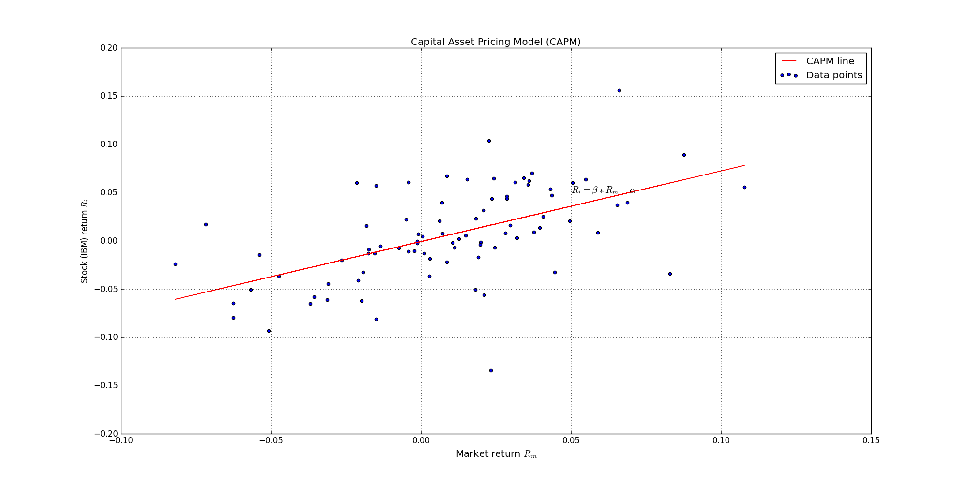
Capital Asset Pricing Model and Regression
E[r_{a}] - r_{f} = α + β_{a} ( E[r_{m}] – r_{f} )

Slide 181
Capital Asset Pricing Model and Regression
The β beta is the only relevant measure of risk – it determines the
additional premium beyond the risk-free rate
What is α alpha?
The α alpha parameter is the difference between the
return and the expected return !!!
α = E[r_{a}] - { r_{f} + β_{a} ( E[r_{m}] – r_{f} ) }
For example: CAPM may estimate that a portfolio should earn 15%
but it actually earned 20%. In this case α alpha
is the difference so 5%
FOR CAPM ALPHA IS ZERO !!!

Slide 182
Hedging the Market Risk (Algorithmic Trading)

Slide 183
Hedging the Market Risk
the Capital Asset Pricing Model (CAPM) shows us the relationship between risk and return
we can not eliminate all the risks in finance
„If you want to make some money, you have to take risks”

Slide 184
Hedging the Market Risk
but there are some strategies that have managed to reduce and eliminate market risk
BLACK-SCHOLES MODEL

Slide 185
Hedging the Market Risk
but there are some strategies that have managed to reduce and eliminate market risk
BLACK-SCHOLES MODEL
PAIRS-TRADING STRATEGY

Slide 186
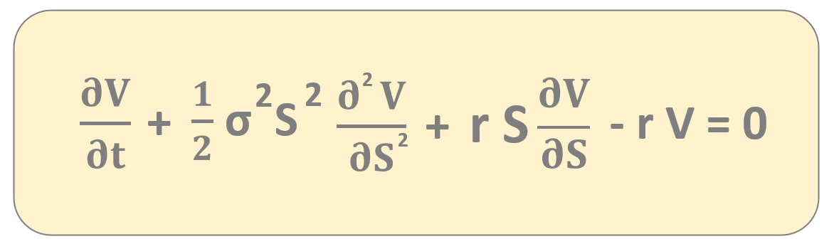
Black-Scholes Model
this is the famous Black-Scholes formula
it deals with a portfolio a derivative (option) and
and underlying stock
RISKY POSITIONS TAKEN TOGETHER CAN EFFECTIVELY ELIMINATE RISK ITSELF !!!

Slide 187
Pairs-Trading Strategy
Pairs-trading strategy is about combining long and short positions in a pair of
highly correlated financial instruments (such as stocks)
→ it is a form of statistical-arbitrage strategy
developed in the 1980s at Morgan-Stanley company
S(t)
Pepsi (PEP) and CocaCola (KO) are companies
with similar products – they are historically correlated
if PEP goes up a significant amount while KO stays the same
pairs trader should buy KO stock and sell PEP stock
TRADERS ASSUME THE COMPANIES WOULD RETURN TO THEIR HISTORICAL BALANCE POINT !!!
Coca-Cola
Pepsi
t

Slide 188
Stochastic Processes (Algorithmic Trading)

Slide 189
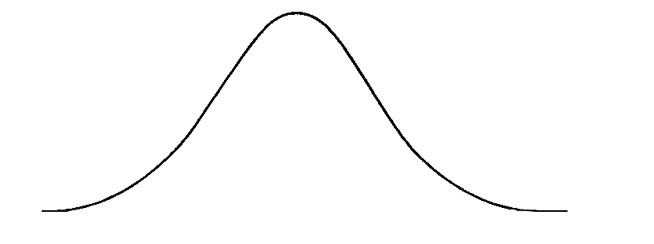
Stochastic Processes
WIENER-PROCESS
→ W(t) has independent increments: future W(t+dt) – W(t)
increments are independent of past values
W(t) has Gaussian increments: W(t+dt)-W(t) is normally
distributed with mean 0 and variance dt
W(t+dt) – W(t) ~ N(0,dt)
S(t)
asset
tomorrow
asset today
Wiener-process W(t) has continuous paths !!!
t

Slide 190
Stochastic Processes
ORNSTEIN-UHLENBECK PROCESS
dx_{t} = θ(μ-x_{t})dt + σ dW_{t}
this process forms the basis of the model for interest rates
(such as the Vasicek model) or currency exchange rates
(this process is stationary while brownian motion is not)
one application of this process is pairs trading strategy

Slide 191
Stochastic Processes
ORNSTEIN-UHLENBECK PROCESS
σ is the degree of volatility
around the μ mean
dx_{t} = θ(μ-x_{t})dt + σ dW_{t}
μ is the equilibrium or the
mean value and θ is the rate by which the
process reverts towards the mean

Slide 192
Stochastic Processes
ORNSTEIN-UHLENBECK PROCESS
pairs-trading strategy has something to do with mean reversion
we open long or short positions when the given x(t) time series
is far away from the mean under the expectation that x(t)
will revert towards the mean
S(t)
if PEP goes up a significant amount while KO stays the same
pairs trader should buy KO stock and sell PEP stock
TRADERS ASSUME THE COMPANIES WOULD RETURN TO THEIR HISTORICAL BALANCE POINT !!!
Coca-Cola
Pepsi
t

Slide 193
Derivatives (Quantitative Finance)

Slide 194
Derivatives
A derivative is a security with a price that is derived
from one or more underlying assets.
VALUE OF THE DERIVATIVE IS DETERMINED BY THE
FLUCTUATIONS IN THE UNDERLYING ASSET !!!
the underlying assets may be stocks, bonds,
currencies or interest rates

Slide 195
Derivatives
– HEDGE RISK –
Derivatives have been popular in the physical market. The aim of
using derivatives is to minimize risk (similar to insurance policies).

Slide 196
Derivatives
– HEDGE RISK –
Derivatives have been popular in the physical market. The aim of
using derivatives is to minimize risk (similar to insurance policies).
– SPECULATION –
Maybe a more popular application of derivatives is to make profit.

Slide 197

Derivatives
the largest operating cost of airlines
is typically fuel expenses
FLUCTUATING OIL PRICES HAVE A HUGE IMPACT ON THESE COMPANIES !!!
HEDGING RISK

Slide 198



Derivatives
the lagest operating cost of airlines
is typically fuel expenses
FLUCTUATING OIL PRICES HAS A HUGE IMPACT ON THESE COMPANIES !!!
HEDGING RISK
COMMODITIES (SUCH AS OIL)
ARE EXTREMELY VOLATILE !!!
S(t)
t

Slide 199
Derivatives
the lagest operating cost of airlines
is typically fuel expenses
FLUCTUATING OIL PRICES HAS A HUGE IMPACT ON THESE COMPANIES !!!
HEDGING RISK
THIS IS WHEN DERIVATIVES ARE USEFUL !!!
Airlines can hedge the risk of rising oil prices. They can open buy contracts that enable them to buy commodities (oil) at today’s price.
COMMODITIES (SUCH AS OIL)
ARE EXTREMELY VOLATILE !!!
S(t)
t

Slide 200
Derivatives
both of the parties have risks due to fluctuating oil prices
rising oil prices are good for oil companies and falling oil prices are good for airlines
THIS IS WHY DERIVATIVES ARE USEFUL FOR EVERYONE !!!
they may sign a contract that the oil company will sell x barrel of oil to the given airline at the current market price of $m in n months regardless of the future market price

Slide 201

Derivatives
we may want to use derivatives and
buy crude oil at today’s price in the future
because we expect the price to increase
SPECULATION
S(t)
$x
t
t
T
WE CAN MAKE A PROFIT OF $x BECAUSE THE OIL PRICES HAVE INCREASED !!!

Slide 202
Derivatives
TYPES OF DERIVATIVES
– FORWARD CONTRACTS –
It is basically a contract between 2 parties to buy or sell a given asset (stock, bond or commodity) at a given price in the future. These are not regulated and are not present on the stock exchange.

Slide 203
Derivatives
TYPES OF DERIVATIVES
– FORWARD CONTRACTS –
It is basically a contract between 2 parties to buy or sell a given asset (stock, bond or commodity) at a given price in the future. These are not regulated and are not present on the stock exchange.
– FUTURE CONTRACTS –
Very similar to forward constract but they are regulated and they are traded
at the so-called futures exchange

Slide 204
Derivatives
TYPES OF DERIVATIVES
– FORWARD CONTRACTS –
It is basically a contract between 2 parties to buy or sell a given asset (stock, bond or commodity) at a given price in the future. These are not regulated and are not present on the stock exchange.
– FUTURE CONTRACTS –
Very similar to forward constract but they are regulated and they are traded
at the so-called futures exchange
– SWAPS –
It is a contract that a given asset will be exchanged for another in the future.

Slide 205
Derivatives
TYPES OF DERIVATIVES
– FORWARD CONTRACTS –
It is basically a contract between 2 parties to buy or sell a given asset (stock, bond or commodity) at a given price in the future. These are not regulated and are not present on the stock exchange.
– FUTURE CONTRACTS –
Very similar to forward constract but they are regulated and they are traded
at the so-called futures exchange
– SWAPS –
It is a contract that a given asset will be exchanged for another in the future.
– OPTIONS –
It is a contract that gives the right (without the obligation) to buy or sell
a given asset at a given price in the future.

Slide 206
Forward and Future Contracts (Quantitative Finance)

Slide 207
Forward and Future Contracts
Forward and future contracts are agreements between two parties
for the sale of an asset at an agreed price
it is possible to hedge against risk during
a given period of time

Slide 208
Forward and Future Contracts
FORWARDS
this is a private agreement between
2 parties to buy or sell a given
asset in the future for a specific price
these are private agreements
and not traded on exchanges
forwards and not regulared
and standardized
FUTURES
this is a contract between 2 parties
to buy or sell a given asset in the
future for a specific price
futures and regulared
and standardized
they are traded on exchanges
and transactions are guaranteed

Slide 209
Forward and Future Contracts
EXAMPLE
Tom owns 5000 shares of IBM with value $50 per share
fearing that the value of his shares would decline Tom arranges
a future contact to protect the value of his stocks
Bob on the other hand speculates that IBM stocks will rise in value
so they agree that in 1 year’s time Bob will buy Tom’s 5000
shares at their current value of $50 !!!

Slide 210
Swaps (Quantitative Finance)

Slide 211
Swaps
„Swaps are financial derivatives between 2 parties to exchange financial assets, cashflows or payments for a certain time”

Slide 212
Swaps
the first swap was constructed back in 1981 between IBM and the World Bank
the objective of a swap is to change one scheme of payments into another one of a different nature
for example floating and fixed interest rates

Slide 213
Swaps
TYPES OF SWAPS
– INTEREST RATE SWAPS –
This is the simplest and most common type of swaps. It relies on 2 parties (companies) one with fixed interest rate and the other with floating interest rate.

Slide 214
Swaps
TYPES OF SWAPS
– INTEREST RATE SWAPS –
This is the simplest and most common type of swaps. It relies on 2 parties (companies) one with fixed interest rate and the other with floating interest rate.
– CURRENCY SWAPS –
In a currency swap both parties exchange principal and interest payments
on debt that is denominated in different currencies.

Slide 215
Swaps
TYPES OF SWAPS
– INTEREST RATE SWAPS –
This is the simplest and most common type of swaps. It relies on 2 parties (companies) one with fixed interest rate and the other with floating interest rate.
– CURRENCY SWAPS –
In a currency swap both parties exchange principal and interest payments
on debt that is denominated in different currencies.
– CREDIT DEFAULT SWAPS (CDSs) –
It is an agreement by a single party to pay the principal amount that is lost as well as the interest on a loan to the CDS buyer if the borrower defaults on their loan.

Slide 216
Interest Rate Swaps
r(t)
the main problem is that r(t) market
interest rates are fluctuating all the time
COMPANIES THAT HAVE LOANS ARE
DEPENDING ON THE INTEREST RATE !!!
of course there are fixed rate loans as well
t

Slide 217
Interest Rate Swaps
the given company can borrows money
from a lender (usually a bank)
the company agrees to pay interests to the lender
(every company has different credit scoring so the
price of borrowing money differs as well)
IF THE INTEREST RATE INCREASES, THE COMPANY PAYS MORE MONEY TO THE LENDER !!!

Slide 218

Interest Rate Swaps
company #1
(with better credit score)
company #2
(with lower credit score)

Slide 219

Interest Rate Swaps
company #1
(with better credit score)
company #2
(with lower credit score)
Floating: L.I.B.O.R.
Fixed: 6%
Floating: L.I.B.O.R. + 1%
Fixed: 9%

Slide 220
Interest Rate Swaps
investment bank
(swap issuer)
company #1
(with better credit score)
company #2
(with lower credit score)
Floating: L.I.B.O.R.
Fixed: 6%
Floating: L.I.B.O.R. + 1%
Fixed: 9%

Slide 221
Interest Rate Swaps
investment bank
(swap issuer)
L.I.B.O.R.
7.5%
company #1
(with better credit score)
company #2
(with lower credit score)
Floating: L.I.B.O.R.
Fixed: 6%
Floating: L.I.B.O.R. + 1%
Fixed: 9%

Slide 222
Interest Rate Swaps
investment bank
(swap issuer)
L.I.B.O.R.
L.I.B.O.R.
7%
7.5%
company #1
(with better credit score)
company #2
(with lower credit score)
Floating: L.I.B.O.R.
Fixed: 6%
Floating: L.I.B.O.R. + 1%
Fixed: 9%

Slide 223
Interest Rate Swaps
investment bank
(swap issuer)
L.I.B.O.R.
L.I.B.O.R.
7%
7.5%
company #1
(with better credit score)
company #2
(with lower credit score)
Floating: L.I.B.O.R.
Fixed: 6%
Floating: L.I.B.O.R. + 1%
Fixed: 9%

Slide 224



Interest Rate Swaps
it is paying 8.5%
which is better than the
bank’s offer
investment bank
(swap issuer)
L.I.B.O.R.
L.I.B.O.R.
7%
7.5%
company #1
(with better credit score)
company #2
(with lower credit score)
Floating: L.I.B.O.R.
Fixed: 6%
Floating: L.I.B.O.R. + 1%
Fixed: 9%

Slide 225

Interest Rate Swaps
investment bank
(swap issuer)
L.I.B.O.R.
L.I.B.O.R.
7%
7.5%
company #1
(with better credit score)
company #2
(with lower credit score)
the investment bank
is making a profit of 0.5%
Floating: L.I.B.O.R.
Fixed: 6%
Floating: L.I.B.O.R. + 1%
Fixed: 9%

Slide 226
Interest Rate Swaps
investment bank
(swap issuer)
this company
is paying
L.I.B.O.R – 1%
L.I.B.O.R.
L.I.B.O.R.
7%
7.5%
company #1
(with better credit score)
company #2
(with lower credit score)
Floating: L.I.B.O.R.
Fixed: 6%
Floating: L.I.B.O.R. + 1%
Fixed: 9%

Slide 227
Options (Quantitative Finance)

Slide 228
Options
„Options are contracts that give the bearer the right, but not the obligation, to either buy or sell an amount of some underlying asset”

Slide 229
Options
options are very similar to forwards and futures
futures are contracts between 2 parties to buy or sell a given asset (stock, bond or commodity) at a given price in the future
THE HOLDER OF THE CONTRACT IS OBLIGED TO TRADE !!!
the option gives the holder the right to trade in the future at a previously agreed price
THERE ARE NO OBLIGATIONS AT ALL !!!

Slide 230
Options
if we have bought a stock option
it gives the right (not the obligation) to buy
the given stock in the future (t=T)
WE WILL BUY THE UNDERLYING STOCK
IF IT HAS INCREASED IN VALUE !!!
otherwise we do not buy the stock
(we can not do that with future contracts)
S(t)
$x
t
t=0
t=T

Slide 231
Options
if we have bought a stock option
it gives the right (not the obligation) to buy
the given stock in the future (t=T)
WE WILL NOT BUY THE UNDERLYING STOCK
IF IT HAS DECREASED IN VALUE !!!
otherwise we do not buy the stock
(we can not do that with future contracts)
S(t)
-$x
t
t=0
t=T

Slide 232
Options
S(t)
HOW MUCH WOULD YOU PAY FOR A GIVEN OPTION?
the famous Black-Scholes model
can calculate the value of a given option
-$x
t
t=0
t=T

Slide 233
Call Options (Quantitative Finance)

Slide 234
Call Options
„Call option is the right to buy a particular asset (stock) for
an agreed E price at a specific T time in the future”

Slide 235
Call Options
For example you can buy a call option on IBM. It gives the right to buy
one IBM stock for $30 in 1 month’s time. Today’s price is $25
E=$30
exercise price
(strike price)
S(t)
$x
t
t=0
t=T

Slide 236
Call Options
For example you can buy a call option on IBM. It gives the right to buy
one IBM stock for $30 in 1 month’s time. Today’s price is $25
E=$30
exercise price
(strike price)
S(t)
T=1
expiration date or expiry
$x
t
t=0
t=T

Slide 237
Call Options
For example you can buy a call option on IBM. It gives the right to buy
one IBM stock for $30 in 1 month’s time. Today’s price is $25
E=$30
exercise price
(strike price)
S(t)
T=1
expiration date or expiry
$x
S(t)
stock price
that is fluctuating
t
t=0
t=T

Slide 238
Call Options
For example you can buy a call option on IBM. It gives the right to buy
one IBM stock for $30 in 1 month’s time. Today’s price is $25
E=$30
exercise price
(strike price)
S(t)
T=1
expiration date or expiry
$x
S(t)
stock price
that is fluctuating
t
t=0
t=T
V(S,t)
price of the call option

Slide 239
Call Options
For example you can buy a call option on IBM. It gives the right to buy
one IBM stock for $30 in 1 month’s time. Today’s price is $25
V(S,T)
max(S_{T}-E, 0)
this is what the
call option worth
at T expiry
this is the payoff-diagram
for a call option
FOR A CALL OPTION WE SPECULATE THAT
THE STOCK WILL RISE !!!
S(t) = E
if the stock price has decreased in value then we
do not buy the underlying stock, otherwise
we make a profit of S-E
S(t)
V(S,0) is negative
because we pay
for the option

Slide 240
Put Options (Quantitative Finance)

Slide 241
Put Options
„Put option is the right to sell a particular asset (stock) for
an agreed E price at a specific T time in the future”

Slide 242
Put Options
For example you can buy a put option on IBM. It gives the right to sell
one IBM stock for $25 in 1 month’s time. Today’s price is $25
E=$25
exercise price
(strike price)
S(t)
$x
t
t=0
t=T

Slide 243
Put Options
For example you can buy a put option on IBM. It gives the right to sell
one IBM stock for $25 in 1 month’s time. Today’s price is $25
E=$25
exercise price
(strike price)
S(t)
T=1
expiration date or expiry
$x
t
t=0
t=T

Slide 244
Put Options
For example you can buy a put option on IBM. It gives the right to sell
one IBM stock for $25 in 1 month’s time. Today’s price is $25
E=$25
exercise price
(strike price)
S(t)
T=1
expiration date or expiry
$x
S(t)
stock price
that is fluctuating
t
t=0
t=T

Slide 245
Put Options
For example you can buy a put option on IBM. It gives the right to sell
one IBM stock for $25 in 1 month’s time. Today’s price is $25
E=$25
exercise price
(strike price)
S(t)
T=1
expiration date or expiry
$x
S(t)
stock price
that is fluctuating
t
t=0
t=T
V(S,t)
price of the call option

Slide 246
Put Options
For example you can buy a put option on IBM. It gives the right to sell
one IBM stock for $25 in 1 month’s time. Today’s price is $25
V(S,T)
max(E-S_{T}, 0)
this is what the
call option worth
at T expiry
this is the payoff-diagram
for a put option
FOR A PUT OPTION WE SPECULATE THAT
THE STOCK WILL FALL !!!
S(t) = E
if the stock price has increased in value then we
do not buy the underlying stock, otherwise
we make a profit of E-S_{T}
S(t)
V(S,t) may be negative
because we pay
for the option

Slide 247
American and European Options (Quantitative Finance)

Slide 248
American and European Options
– AMERICAN OPTIONS –
American option may be exercised at any t<T time
before the expiration date

Slide 249
American and European Options
– AMERICAN OPTIONS –
American option may be exercised at any t<T time
before the T expiration date
– EUROPEAN OPTIONS –
European option may be exercised only at a single pre-defined point in time which is the T expiration date

Slide 250
Credit Default Swaps (Quantitative Finance)

Slide 251
Credit Default Swap (CDS)
a given company needs capital
to expand it’s business
IT ISSUES BONDS THAT PAYS INTERESTS FOR A CERTAIN PERIOD OF TIME !!!

Slide 252
Credit Default Swap (CDS)
a given company needs capital
to expand it’s business
IT ISSUES BONDS THAT PAYS INTERESTS FOR A CERTAIN PERIOD OF TIME !!!
there are pension funds, corporations or
other investors who buy these bonds

Slide 253
Credit Default Swap (CDS)
a given company needs capital
to expand it’s business
IT ISSUES BONDS THAT PAYS INTERESTS FOR A CERTAIN PERIOD OF TIME !!!
there are pension funds, corporations or
other investors who buy these bonds
DEFAULT

Slide 254

Credit Default Swap (CDS)
a given company needs capital
to expand it’s business
IT ISSUES BONDS THAT PAYS INTERESTS FOR A CERTAIN PERIOD OF TIME !!!
„A credit default swap is a derivative (swap contract) that the seller of the CDS will compensate the buyer in the event of a debt default”
there are pension funds, corporations or
other investors who buy these bonds
DEFAULT

Slide 255
Credit Default Swap (CDS)
it is a credit derivative that enables investors to swap credit risk
the buyer of the CDS pays installments (fixed payments) to the seller until date of maturity
the seller of the CDS agrees to pay the interest payments if the bond issuer may default

Slide 256
Credit Default Swap (CDS)
there are pension funds,
corporations or other investors
who buy these bonds
+ CDS buyer !!!
a given company needs capital
to expand it’s business and pays the
interests to the investor
investment bank
(CDS seller) pays
the interests in case
the company defaults

Slide 257
Types of Analysis (Quantitative Finance)

Slide 258
Types of Analysis
FUNDAMENTAL ANALYSIS

Slide 259
Types of Analysis
FUNDAMENTAL ANALYSIS
TECHNICAL ANALYSIS

Slide 260
Types of Analysis
FUNDAMENTAL ANALYSIS
TECHNICAL ANALYSIS
QUANTITATIVE ANALYSIS

Slide 261
Fundamental Analysis
fundamental analysis is about the in-depth
study of a given company
there are several factors to consider – management teams,
products and services, balance sheets, income statements etc.
WE PREDICT WHETHER THE STOCK IS UNDERVALUD OR NOT BASED ON THE INTRINSIC VALUE OF THE COMPANY !!!
we may have a good model for the value of a given company
The rest of the world should see the mispricings
as well and this may never happen !!!
there are several companies
present on the stock marker

Slide 262
Fundamental Analysis
we check the assets of the company (such as cash, properties and equipments)
we check liabilities as well (debts and loans)
usually we look at the income statement of a company to know how the company makes money (revenues and expenses)
NET INCOME = REVENUES – EXPENSES
the company can share the net income with shareholders (dividens) or it can be reinvested into the company

Slide 263

Fundamental Analysis
it is good to reinvest the net income into the company
a company with good cash position has quite a low probability of default (this why to consider cash flow statement)
P/E ratio is a powerful tool in fundamental analysis
the net income divided by
the number of outstanding shares
is the earnings per share
$\frac{NET INCOME}{\# SHARES}$ = EPS

Slide 264
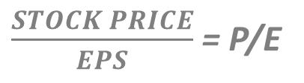
Fundamental Analysis
it is good to reinvest the net income into the company
a company with good cash position has quite a low probability of default (this why to consider cash flow statement)
P/E ratio is a powerful tool in fundamental analysis
$\frac{STOCK PRICE}{EPS}$ = P/E
this is the price to earning
ratio – the lower the better

Slide 265
Technical Analysis
it is a opposite of fundamental analysis – this approach
does not care about the company
all the information is contained within its stock
TECHNICAL ANALYSIS IS ABOUT HISTORICAL DATA !!!
we have to interpret historical data and look for
specific patterns in the S(t) stock price
to make predictions accordingly
(machine learning, time series model etc.)
S(t)
t

Slide 266

Quantitative Analysis
quantitative analysis has an assumption:
all financial quantities such as S(t) stock prices
or r(t) interest rates have random behavior
QUANTITATIVE ANALYSIS TRY TO MODEL
THE BEHAVIOR OF FINANCIAL ASSETS !!!
we have to use randomness in our models
so stochastic calculus and stochastic
differential equations are needed

Slide 267
Random Behavior (Quantitative Finance)

Slide 268
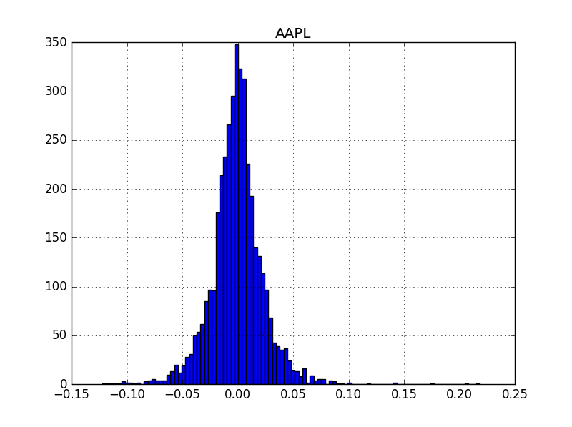
Random Behavior
S(t) - S(t-1)
daily return in
the [t,t-1] interval
= R(t)
S(t-1)
As we have seen the daily returns (or monthly returns)
have approximately normal distributions
normal distributions can be defined by two
parameters – μ mean and σ² variance
so maybe the daily returns can be defined with
these parameters (mean and variance) as well
we can define return as a
random variable drawn from a
normal distribution
R(t) = mean + x * standard deviation

Slide 269
Random Behavior
R(t) = mean + x * standard deviation
S(t)
We can define daily returns as random variables
drawn from a normal distribution
S(t+1) asset
price tomorrow
Stock price S(t) can be described by a
W(t) random walk (so-called Wiener process)
S(t) asset
price today
W(t) has continuous sample path
it has independent and normally
distributed increments
t

Slide 270
Random Behavior
σ standard deviation
above the μ mean
S(t)
μ mean
σ standard deviation
below the μ mean
t

Slide 271
Wiener Process and Random walk (Quantitative Finance)

Slide 272
Wiener Process and Random Walk
the returns of a given stock price is N(μ,σ²) normally distributed
what is the distribution of the stock prices?
normal distribution is not working fine as stock prices can not have negative values (+ stock values keep increasing)
STOCK PRICES FOLLOW LOG-NORMAL DISTRIBUTION
in probability theory a log-normal distribution is a continuous probability distribution of a random variable whose logarithm is normally distributed
so if the random variable X is log-normally distributed then Y = ln(X) has a normal distribution

Slide 273
Wiener Process and Random Walk
This W(t) pricess is called Wiener-process
W(t) has independent increments: future W(t+dt) – W(t)
increments are independent of past values
W(t) has Gaussian increments: W(t+dt)-W(t) is normally
distributed with mean 0 and variance dt
W(t+dt) – W(t) ~ N(0,dt)
S(t)
S(t+1) asset
price tomorrow
S(t) asset
price today
t

Slide 274
Wiener Process and Random Walk
dS = 𝝻 S dt + 𝞂 S dW
formula of geometric
random walk
this is the S(t+dt)-S(t)
change in the
stock price
deterministic part – the drift
stochastic part with
Wiener-process
Basically dW is a random variable drawn from a normal
distribution with mean 0 and variance dt
THIS IS A STOCHASTIC DIFFERENTIAL EQUATION !!!
continuous model of asset prices
this is the fundamental assumption for most
of the modern financial models

Slide 275
Stochastic Calculus (Quantitative Finance)

Slide 276
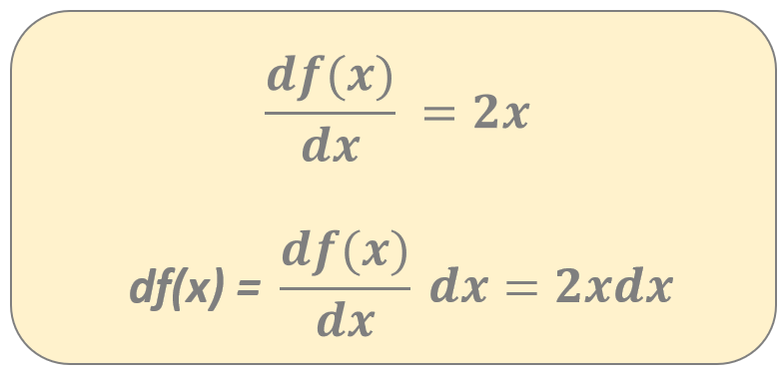
Stochastic Calculus
ORDINARY FUNCTIONS (with deterministic variables)
f(x) = x²
what is the derivative of
the f(x) ordinary function?
When we are dealing with stochastic random variables
this operation is not going to be true !!!

Slide 277
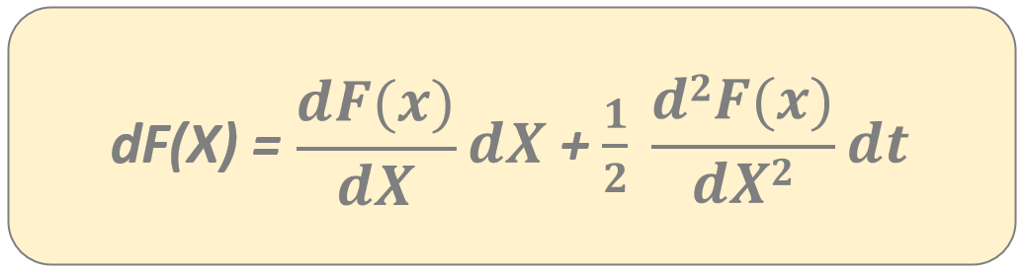
Stochastic Calculus
STOCHASTIC RANDOM VARIABLES
F(X) = X²
here we are dealing with an X(t) random
variable – for example a Wiener-process
we have to use the so-called
Ito’s lemma to deal with
stochastic random variables

Slide 278
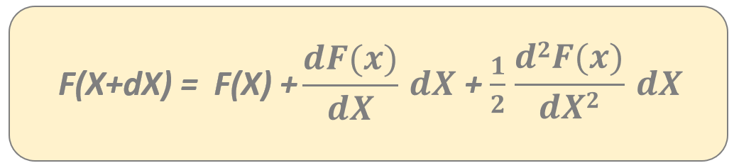
Stochastic Calculus
STOCHASTIC RANDOM VARIABLES
F(X) = X²
here we are dealing with an X(t) random
variable – for example a Wiener-process
we do not assume any stochastic behavior – so we are
using ordinary calculus and Taylor expansion
we assume that E[dX]=0 and E[dX²]=dt

Slide 279
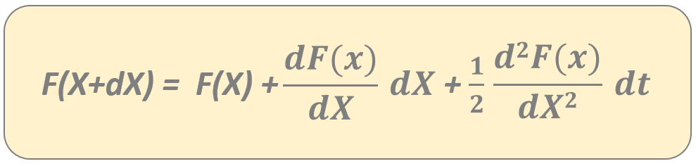
Stochastic Calculus
STOCHASTIC RANDOM VARIABLES
F(X) = X²
here we are dealing with an X(t) random
variable – for example a Wiener-process
we do not assume any stochastic behavior – so we are
using ordinary calculus and Taylor expansion
we assume that E[dX]=0 and E[dX²]=dt

Slide 280
Stochastic Calculus
STOCHASTIC RANDOM VARIABLES
F(X) = X²
here we are dealing with an X(t) random
variable – for example a Wiener-process
we have to use the so-called
Ito’s lemma to deal with
stochastic random variables
SOLUTION:
dF(X) = 2XdX + dt

Slide 281
Stochastic Calculus (Quantitative Finance)

Slide 282
Stochastic Calculus
dS(t) = 𝝻 S(t) dt + 𝞂 S(t) dW(t)

Slide 283
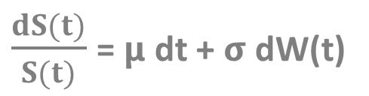
Stochastic Calculus
dS(t) = 𝝻 S(t) dt + 𝞂 S(t) dW(t)
$\frac{dS(t)}{S(t)}$ = 𝝻 dt + 𝞂 dW(t)

Slide 284
Stochastic Calculus
dS(t) = 𝝻 S(t) dt + 𝞂 S(t) dW(t)
$\frac{dS(t)}{S(t)}$ = 𝝻 dt + 𝞂 dW(t)
d(logS(t)) = 𝝻 dt + 𝞂 dW(t)

Slide 285
Stochastic Calculus
dS(t) = 𝝻 S(t) dt + 𝞂 S(t) dW(t)
$\frac{dS(t)}{S(t)}$ = 𝝻 dt + 𝞂 dW(t)
d(logS(t)) = 𝝻 dt + 𝞂 dW(t)
F(S) = log S(t)

Slide 286
Stochastic Calculus
F(S) = log S(t)

Slide 287
Stochastic Calculus
F(S) = log S(t)
2

Slide 288
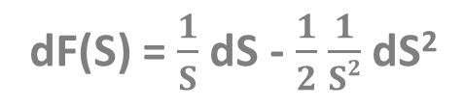
Stochastic Calculus
F(S) = log S(t)
2
dF(S) = $\frac{1}{S}$ dS - $\frac{1}{2}$ $\frac{1}{S2}$ dS²

Slide 289
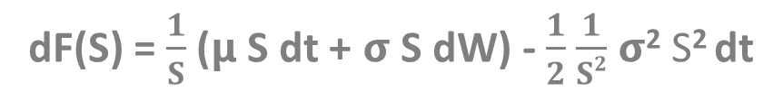
Stochastic Calculus
F(S) = log S(t)
2
dF(S) = $\frac{1}{S}$ dS - $\frac{1}{2}$ $\frac{1}{S2}$ dS²
dF(S) = $\frac{1}{S}$ (𝝻 S dt + 𝞂 S dW) - $\frac{1}{2}$ $\frac{1}{S2}$ 𝞂² S² dt

Slide 290
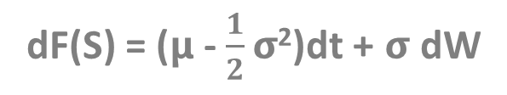
Stochastic Calculus
F(S) = log S(t)
2
dF(S) = $\frac{1}{S}$ dS - $\frac{1}{2}$ $\frac{1}{S2}$ dS²
dF(S) = $\frac{1}{S}$ (𝝻 S dt + 𝞂 S dW) - $\frac{1}{2}$ $\frac{1}{S2}$ 𝞂² S² dt
dF(S) = (𝝻 - $\frac{1}{2}\text{σ}$²)dt + 𝞂 dW

Slide 291

Stochastic Calculus
(𝝻 - $\frac{1}{2}\text{σ}$²) t + 𝞂 W_{t}
S(t) = S(0) e

Slide 292
Interest Rate Modeling (Quantitative Finance)

Slide 293
Interest Rate Modeling
r(t)
the main problem is that r(t) market
interest rates are fluctuating all the time
COMPANIES THAT HAVE LOANS ARE
DEPENDING ON THE INTEREST RATE !!!
+ we need the r(t) interest rate
when pricing bonds as well
t

Slide 294
Vasicek Model
this model was first introduced in 1977 by Oldřich Vašíček
this is a simple short-rate r(t) model
bonds, mortgages and credit derivatives are quite sensitive to r(t) interest rate changes
interest rate modeling is considered quite a complex topic
r(t) interest rates are affected by several factors – political decisions, government intervention and economic states

Slide 295
Vasicek Model
The Vasicek model assumes that the r(t) interest rates follows
a mean-reverting Ornstein-Uhlenbeck process
there is a stochastic random noise
defined by σ standard deviation
THIS MODEL ALLOWS
r(t) INTEREST RATES TO
BE NEGATIVE !!!
dr(t) = Ϗ (θ-r(t))dt + σ dW(t)
the r(t) interest rate fluctuates
around θ – where Ϗ is the speed
of mean reversion

Slide 296
Long Term Investing (Quantitative Finance)

Slide 297

Long Term Investing
Algorithmic trading is about making money quickly using
quantitative methods to outperform the market !!!
VALUE INVESTING Benjamin Graham’s and Warren Buffet’s strategy
this is a strategy where stocks are selected that
trade for less than their intrinsic value
so stocks that are considered to be undervalued by the market
(technical analysis is important)
value investors believe the market overreacts to news
(whether bad or good news) resulting in stock price movements
that do not correspond with a company’s long-term fundamentals !!!

Slide 298
Long Term Investing
value investors have the tendency to invest in companies
not in stocks (companies with good long-term prospects)
value investors buy stocks when the market price is significantly
below the underlying value (undervalued stocks)
value investing is a long-term investing - „buy and hold” strategy
No short-term trends, no quantitative methods to hedge risk
no machine learning techniques and short-term mispricings
value investors ignore the crowd: most people buy shares when
the given stock price arises + sell when prices decline (buy high sell low behavior)
Value investors decide whether to buy or sell according to the
relationship between the value and the price of the stock

Slide 299
Efficient Market Hypothesis (Quantitative Finance)

Slide 300
Efficient Market Hypothesis
„It is impossible to beat the market”
because stock market efficiency causes existing stock
prices to always reflect all relevant information
according to Efficient Market Hypothesis stocks always trade at their
fair value: making it impossible for investors to buy undervalued stocks
so it is impossible to outperform the market with
stock selection or market timing (and with technical analysis)
THE ONLY WAY AN INVESTOR CAN OBTAIN
HIGHER RETURNS IS TO TAKE MORE RISK !!!

Slide 301
Efficient Market Hypothesis
the movement of S(t) stock prices are totally random (random walk)
dS(t) stock price changes occur in an unpredictable way
all available information is reflected in the S(t) stock price
we can check the outocorrelation of stock returns – these returns should have low autocorrelation according to the hypothesis

Slide 302

Efficient Market Hypothesis
Peter Lynch managed the
Fidelity Magellan Fund from 1977 to 1990.
He achieved an annual average return of 29%.

Slide 303

Efficient Market Hypothesis
The company was founded by James Simons in 1982.
(mathematics and theoretical physics)
It achieved an annual average return of 34%.

Slide 304
Efficient Market Hypothesis
Warren Buffet is another example that
it is possible to bear the market. He achieved
an annual average return of 22%.

Slide 305
Bond Pricing with Vasicek Model (Quantitative Finance)

Slide 306

Zero-Coupon Bonds
HOW MUCH WOULD YOU PAY FOR THIS BOND?
of course it has something to
do with the present value of the
actual principal amount
$1000
10% rate
2 years
$$\frac{x}{\left(1+r\right) }$$
2

Slide 307

Zero-Coupon Bonds
We may construct a continuous model with differential equations
Suppose we have amount x(t) in the bank at time t. How much does this
increase in value from one day to the next?
x(t+dt) – x(t) = $\frac{dx(t)}{dt} dt$
Taylor-expansion or the
definition of derivatives
the change in the amount of
money within a dt day
But the interest I receive must be proportional to the actual x(t) amount
I have and the r interest rate and the dt time step !!!
x(t+dt) – x(t) = r x(t) dt

Slide 308

Zero-Coupon Bonds
We may construct a continuous model with differential equations
Suppose we have amount x(t) in the bank at time t. How much does this
increase in value from one day to the next?
$$\frac{dx(t)}{dt}=r x(t)$$
this is the differential equation
describing the change of our x(t) capital
The solution of this differential equation is x(t) = x(0) e
so the exponential function.
Of course if we want to get the present value of a
future cashflow then we have to use the exponential
function with negative exponent.
r t

Slide 309


Vasicek Model and Bond Pricing
Here we assume that the r(t) interest rate is not constant – it follows a stochastic process
Suppose the principal value of the bond is $x. How much would you pay for this
bond in the present?
$$\int_{t}^{T}{r\left(s\right)ds}$$
we have to calculate the discounted
value of a future cashflow
+ handle the stochastic r(t)
-
$$P=x e$$
we can solve this equation (as well as the Vasicek model)
but we will use Monte-Carlo simulation instead

Slide 310

Vasicek Model and Bond Pricing
r(t)
we generate a huge amount of possible
r(t) interest processes
THE MEAN OF THESE SIMULATIONS YIELDS THE r_{B}(t) INTEREST RATE WITH THE HIGHEST
PROBABILITY IN THE FUTURE !!!
then we can use this expected interest rate
to calculate the price of the bond
t

Slide 311
Vasicek Model and Bond Pricing
f(t)
if we want to calculate the integral of a
given f(x) function
WE USE RECTANGLES AND WE SUM UP THE AREA OF THESE RECTANGLES !!!
of course the smaller rectangles we use the better
will be the result of the calculation
t

Slide 312
Vasicek Model and Bond Pricing
f(t)
if we want to calculate the integral of a
given f(x) function
WE USE RECTANGLES AND WE SUM UP THE AREA OF THESE RECTANGLES !!!
of course the smaller rectangles we use the better
will be the result of the calculation
t

Slide 313
Option Pricing with Monte-Carlo Method (Quantitative Finance)

Slide 314



Option Pricing with Monte-Carlo Simulation
For an option the underlying asset (stock) follows a geometric random walk
→ so by simulating these stochastic processes we can determine
the price of financial instruments (option)
dS(t) = μ S(t) dt + σ S(t) dW
We can obtain the log S(t) because we know that stock prices
can not be negative. So let’s use Ito’s lemma with F(S) = log S(t)
d log S(t) = ( μ - $\frac{1}{2} σ^{2}$)dt + σ dW
log S(t) = log S(0) + ( μ - $\frac{1}{2} σ^{2}$) t + σ $\int_{0}^{t}{dW}$
Wiener-process is a random walk with mean 0 and variance t
so can be rewritten as N(0,t) or $\sqrt{t} N(0,1)$

Slide 315

Option Pricing with Monte-Carlo Simulation
If we make a risk-neutral assumption: the μ drift becomes
the r risk-free interest rate
this exponential function
defines the S(t) stock
price at T maturity
S(T) = S(0) $e^{\text{[(} \text{r}\text{ − }\frac{1}{2} σ^{2}\text{)}\text{T}\text{ + }\text{σ}\sqrt{T} \text{N}\text{(0,1)]}}$
in Monte-Carlo simulation we generate a large amount of stock
price estimates with this equation
the option price is the expected value of a pay-off function
+ we have to use a discounted factor (time value of money)
max(S-E,0) max(E-S,0)
call option
put option

Slide 316
Black-Scholes Model (Quantitative Finance)

Slide 317
Black-Scholes Model
It was published in 1973 by Fisher Black, Robert Merton and Myron Scholes
they constructed a model that can yield the price and
value of an V(S,t) option when t<T
THEY SHOWED THAT COMBINING RISKY ASSETS
CAN ELIMINATE RISK ITSELF !!!
Modern Portfolio Theory is about including several stocks in
a portfolio in order to reduce unsystematic (specific) risk
CAPM is about the β parameter – because we can eliminate unsystematic (specific)
risk, the only relevant risk is market risk (it can not be diversified away)
MARKET-NEUTRAL STRATEGIES: dynamic delta-hedging and pairs-trading
strategies can eliminate all the risks

Slide 318
Black-Scholes Model
The V(S,t,...) value of an option is a function of various parameters
strike price and expiry
are parameters associated
with the given option
V( S , t , σ , μ , E , T , r )
stock price and time
are variables
volatility and mean are
parameters associated
with the stock price
parameter associated with
risk-free rate

